Slide 1

Entrepreneurship & Innovation
Univ. Prof. Dr. Nikolaus Franke

Slide 2


Your choice of the right SBWL
Due to Corona, there are limited possibilities of experiencing
the people behind an SBWL directly – which is of course also important for your decision where to apply!
Prof. Franke has complemented these slides with an audio file – at least you get some more information than just the slides. Just click on the “speaker” symbol ☺!

Slide 3


















How many people does the average US company employ?

Slide 4






The average US company employs
10 people
down from
25 in 1990

Slide 5













What do these companies have in common?

Slide 6
What do these companies have in common?

Slide 7













What do these companies have in common?

Slide 8
* 1998
* 2008
* 1997
* 1994
* 2006
* 1976/1997
What do these companies have in common?
* 2006
* 2003
* 2009
* 2001
* 1987
* 2001
* 2004

Slide 9
What’s behind this?

Slide 10






Innovation:
New ways of creating value
New technologies
New products
New services
New combinations
New processes
New business models

Slide 11


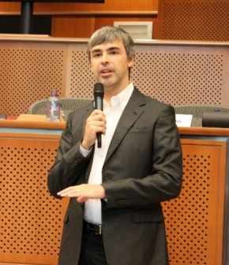



Entrepreneurs: People discovering and exploiting opportunities
Steve Jobs
Mark Zuckerberg
Larry Page
Anita Roddick
Muhammad Yunus
Richard Branson

Slide 12
What is the specialization E&I all about?

Slide 13
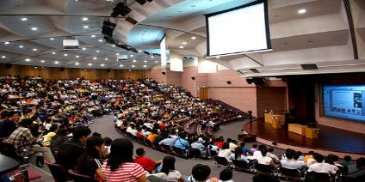





E&I is NOT about
One way teaching
Stupid memorization
Multiple choice
Anonymity
Loneliness
Boredom

Slide 14


What E&I is about
+
Knowledge
Application

Slide 15
E&I specialization courses
The specialization can be completed within 2 semesters. We recommend to take 2-3 semesters.
Knowledge
Course 1: E&I Core Lecture 1
Knowledge
Course 2: E&I Core Lecture 2
Application & Networking
Strategic Management of Innovation
Private Equity und Venture Capital
Steering Innovation Successfully
Fintech Lab: Design your own Startup
Course 3: E&I Zone
Mix
InnoLab
Consulting
Business Planning
EduTech Strategy
Course 4 and 5: E&I Project I and II
New Business Development
Scenario Planning: Anticipate Disruption
Garage: Build your own Start-up
Digital Industrial Innovation
Application

Slide 16
E&I specialization courses
The specialization can be completed within 2 semesters. We recommend to take 2-3 semesters.
Knowledge
Course 1: E&I Core Lecture 1
Knowledge
Course 2: E&I Core Lecture 2
Application & Networking
Strategic Management of Innovation
Private Equity und Venture Capital
Steering Innovation Successfully
Fintech Lab: Design your own Startup
Course 3: E&I Zone
Mix
InnoLab
Consulting
Business Planning
EduTech Strategy
Course 4 and 5: E&I Project I and II
New Business Development
Scenario Planning: Anticipate Disruption
Garage: Build your own Start-up
Digital Industrial Innovation
Application

Slide 17



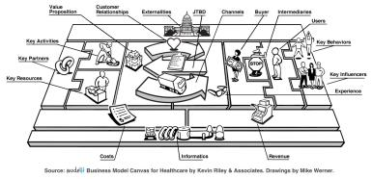


Knowledge courses:
Theory, tools, methods
How to find
breakthrough ideas
How to design winning innovation strategies
How to write a business plan
How to organize the innovation process
How to market innovation
How to finance innovation

Slide 18
E&I specialization courses
The specialization can be completed within 2 semesters. We recommend to take 2-3 semesters.
Knowledge
Course 1: E&I Core Lecture 1
Knowledge
Course 2: E&I Core Lecture 2
Application & Networking
Strategic Management of Innovation
Private Equity und Venture Capital
Steering Innovation Successfully
Fintech Lab: Design your own Startup
Course 3: E&I Zone
Mix
InnoLab
Consulting
Business Planning
EduTech Strategy
Course 4 and 5: E&I Project I and II
New Business Development
Scenario Planning: Anticipate Disruption
Garage: Build your own Start-up
Digital Industrial Innovation
Application

Slide 19
E&I specialization courses
The specialization can be completed within 2 semesters. We recommend to take 2-3 semesters.
Knowledge
Course 1: E&I Core Lecture 1
Knowledge
Course 2: E&I Core Lecture 2
Application & Networking
Strategic Management of Innovation
Private Equity und Venture Capital
Steering Innovation Successfully
Fintech Lab: Design your own Startup
Course 3: E&I Zone
Mix
InnoLab
Consulting
Business Planning
EduTech Strategy
Course 4 and 5: E&I Project I and II
New Business Development
Scenario Planning: Anticipate Disruption
Garage: Build your own Start-up
Digital Industrial Innovation
Application

Slide 20
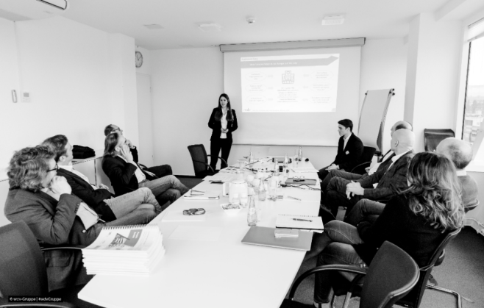




















Application:
Work on real-world business projects!
E&I students have successfully completed 850+ diverse innovation projects:
Work in small teams (4-6 students)
Apply methods like expert interviews, user surveys, business model canvas, etc.
Get individual support from lecturers and external coaches like strategy consultants or venture capitalists

Slide 21
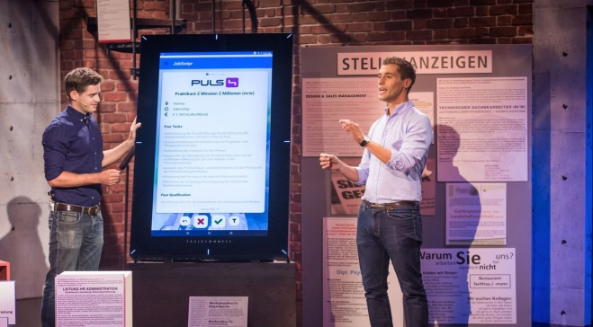













Application:
Garage: Start your own business!
E&I students have successfully founded various start-ups during and after the E&I specialization:
Work on your own ideas in diverse teams (WU, TU, BOKU)
Validate your business model and learn how to pitch in front of investors
Get unique insights from successful founders and experienced market experts

Slide 22







The process of a
“typical” E&I project course
Internal kick-off
Project work
Desk research and/or data collection
Application of specific methods to discover appropriate solutions
Development of recommendations
Final presentation
March 2022
April 2022
May 2022
June 2022
Project partner meeting
Coachings
Mid-term presentation
E&I Touchdown
Get to know
Coordination
Discussion
Presentation workshop
Interview techniques

Slide 23

The E&I Course-O-Meter
Our newly developed E&I Course-O-Meter will help you choose one of our 8 offered project courses based on your preferences.
Co-developed with our E&I students
Short quiz with 5 questions
Result: 2 recommended project courses with short description
NEW!
Try out the Course-O-Meter on our Website:
https://www.wu.ac.at/entrep/lehre/bachelor/choosing-a-project-course

Slide 24
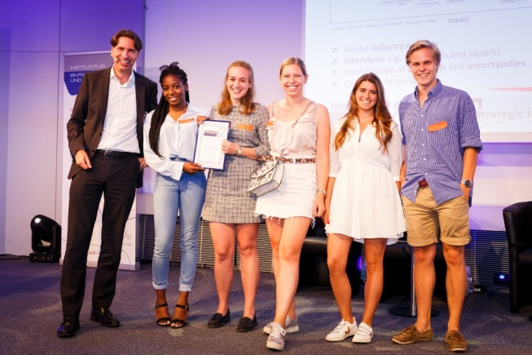


Experience E&I …
… at the
E&I Touchdown
18/01/2022, 5 PM
BACK ON CAMPUS!
For more information, please check our social media channels or our website.
E&I students pitch their innovative solutions to a jury of experts and a broad audience, competing for the Best-Pitch Award.
Join us at the E&I Touchdown and confirm your attendance in the E&I booth to increase your chances in the application process. Admission is free!

Slide 25



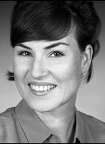
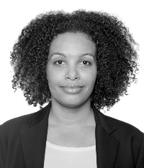

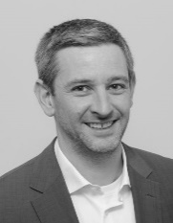

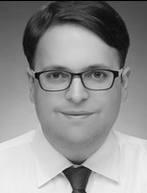
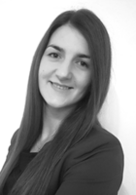


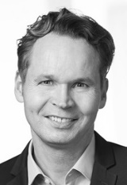
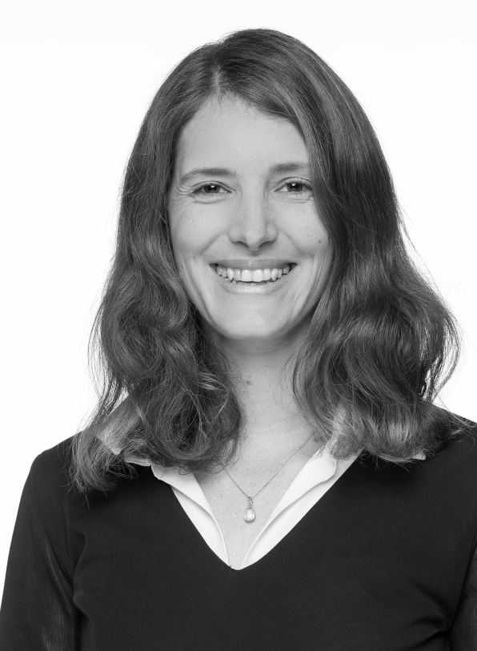
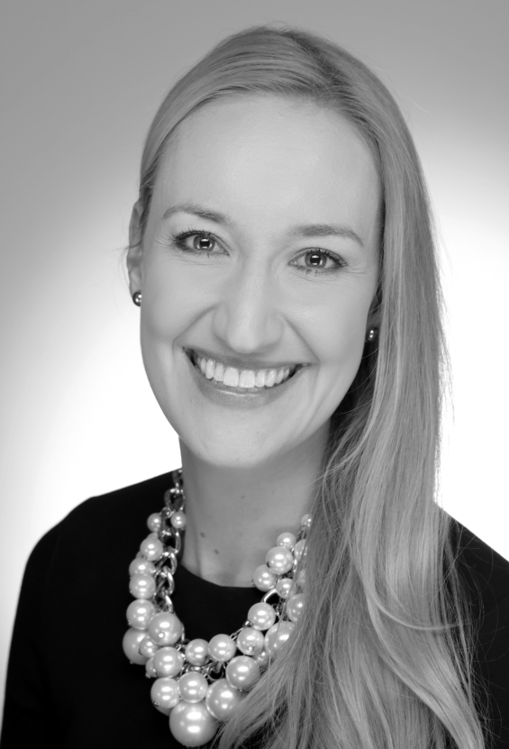
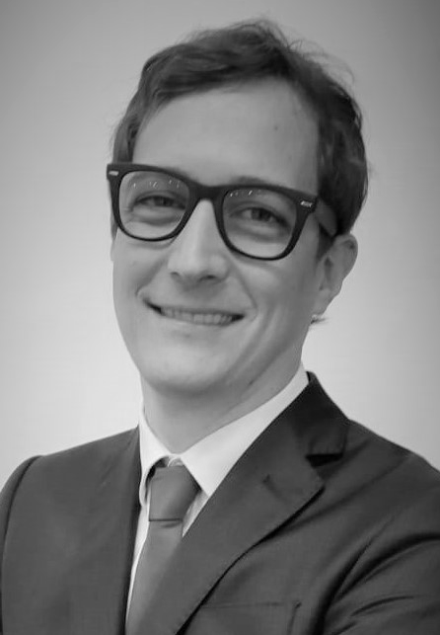
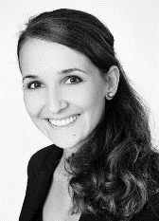
Faculty - Introducing our team
Who are E&I and IfSTO?
Institute for Entrepreneurship and Innovation - Chair
E&I Team
Institute for Strategy, Technology and Organization - Chair
IfSTO Team

Slide 26
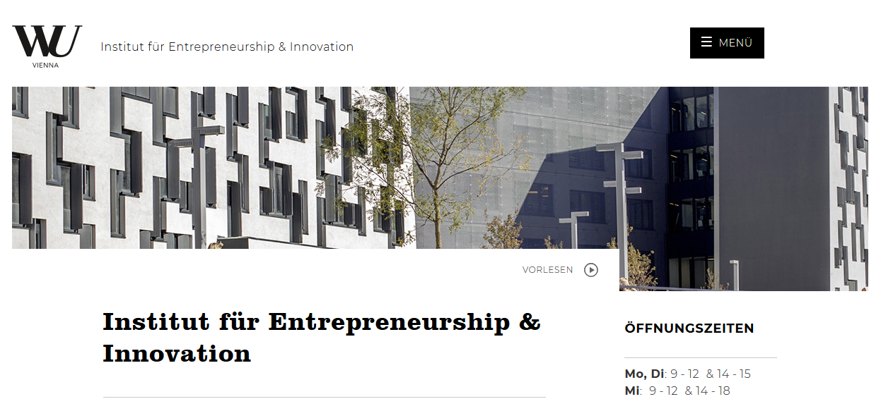
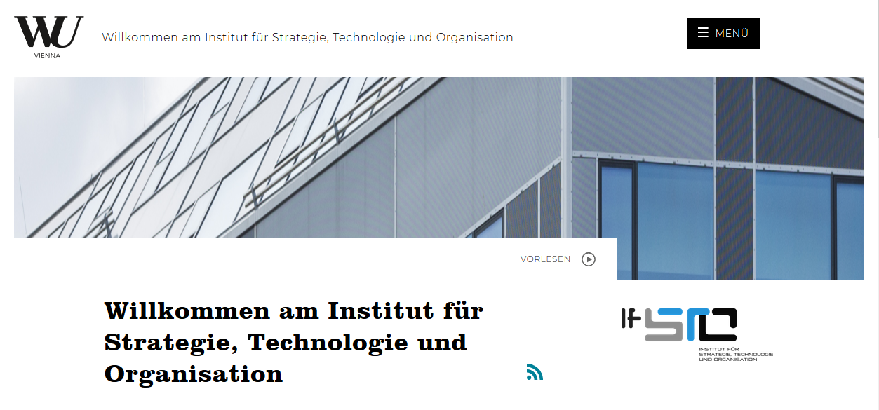



More information
www.wu.ac.at/entrep
www.wu.ac.at/ifsto
E&I @wu.entrepreneurship.innovation
wuentrepreneurship
Institute for Entrepreneurship & Innovation, WU Vienna

Slide 27
More information - E&I Ambassadors
If you have not yet found the information you need about the Entrepreneurship & Innovation specialization on our website, feel free to contact an E&I Ambassador.
The E&I Ambassadors are current and former students of the SBWL and can give you first-​hand insights into our specialization based on their personal experience. In addition, they are happy to provide you with support during your application phase.
https://www.wu.ac.at/entrep/lehre/bachelor/ei-ambassadors

Slide 28
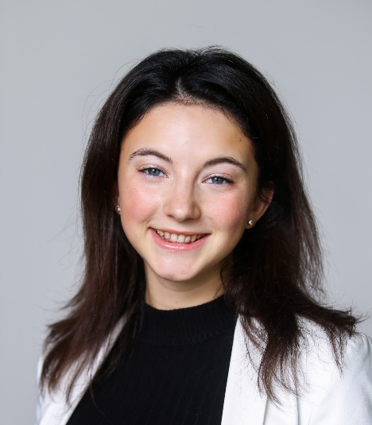
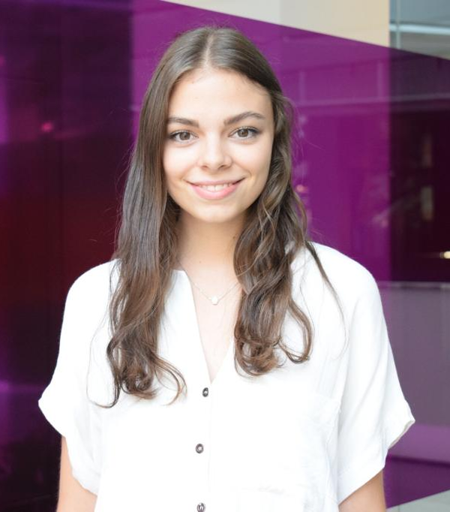
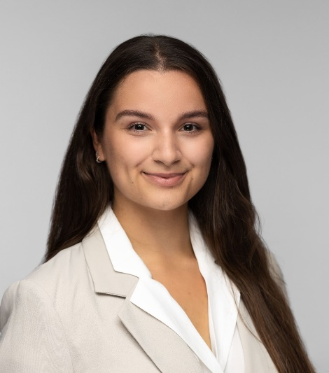
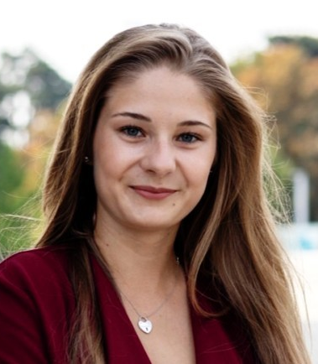
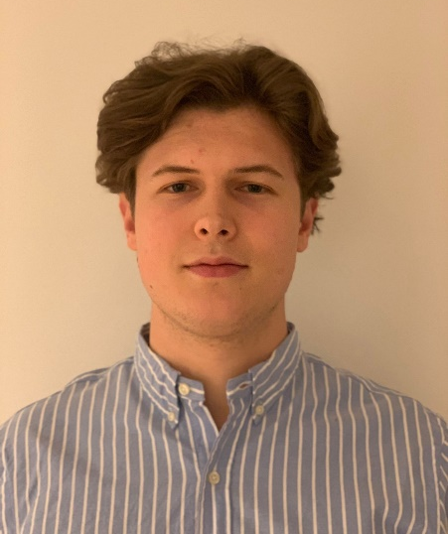

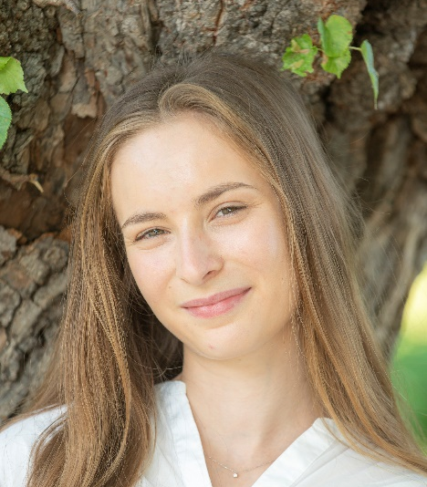



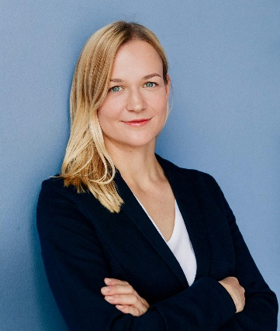
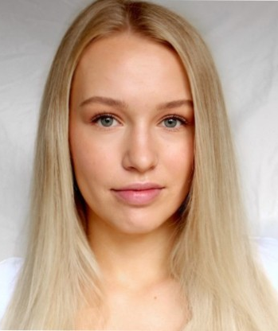
More information - E&I Ambassadors
Felicia Schneider
felicia.schneider@s.wu.ac.at
Denise Alessia Steger
denise.alessia.steger@s.wu.ac.at
Karolina Wick
karolina.wick@s.wu.ac.at
Barbara Binder
barbara.binder1@s.wu.ac.at
Thomas Schmidle
t.schmidle1999@gmail.com
Julian Pfeifer
h11702436@s.wu.ac.at
Sandra Kieffer
sandra.kieffer@s.wu.ac.at
Phillip Grandl
h11737993@wu.ac.at
Carl Horlacher
carl.horlacher@hotmail.de
Stefan Ortner
stefan@ortner-energy.com
Jana Sabel
jana.lisa.sabel@s.wu.ac.at
Stephanie Casper
stephanie.casper@gmx.at

Slide 29
Application process
90 students will be admitted in summer term 2022
Criteria:
  WU student ranking:
  If you are within the top 5% of your cohort, you will be accepted automatically.
    Please make sure that all required grades are listed in time in the ranking you submit to us!
    Please visit www.wu.ac.at/entrep/apply for more information!
  Exceptional E&I skills:
  At least 30 students are accepted ONLY based on their skills
Same application process for all WU study programs!

Slide 30
Application process
www.wu.ac.at/entrep/apply
→ registration via LPIS and online application form is mandatory for all entry modes!
Important dates:
  Jan 27, 2022: Application form online
  Jan 27, 2022: Application period and registration via LPIS starts
  Feb 06, 2022: Final application deadline
  Feb 09, 2022: Notifications about acceptance
  Feb 28, 2022: Welcome @ E&I

Slide 31

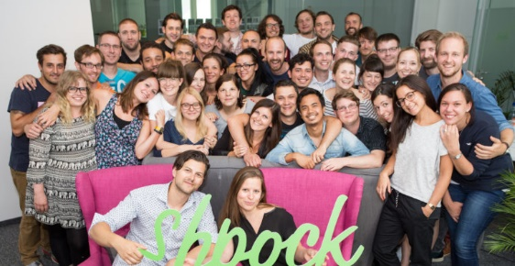
E&I means diversity
Diverse teams are more creative, identify better opportunities, and complement each other regarding skills and competences
This is why we particularly encourage “unusual suspects” to apply for E&I!
Here only two examples of successful female founders/E&I alumnae:
  Cornelia Daniel, founder of Dachgold Katharina Klausberger, founder of shpock https://www.tausendundeindach.at/ https://www.shpock.com

Slide 32
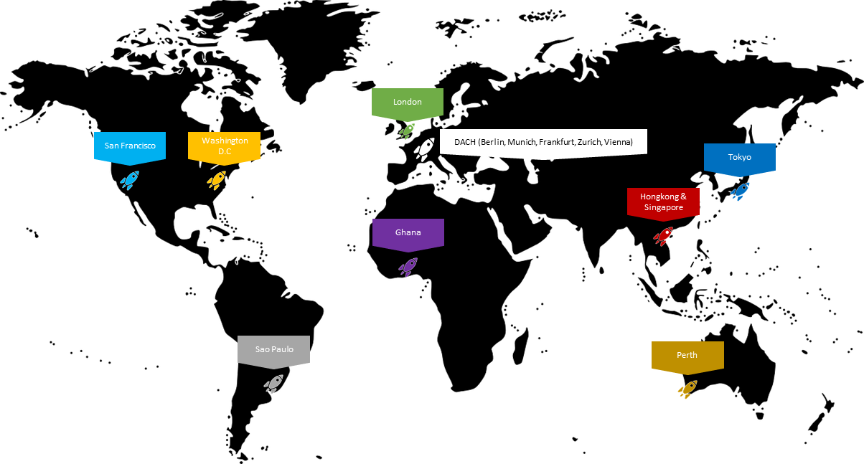
E&I alumni are everywhere
E&I Alumni Network: strong, diverse, entrepreneurial network of 3,000+ E&I alumni (BSc, MSc, MBA, PhD)
E&I Hubs: informal Alumni meetups around the world (mostly in cities with a strong startup scene/ecosystem)
Various events during semester in Vienna:
E&I Stammtisch@Alumni corporates/startups; Aperitivo (WU Ball); professional skills workshops; meet & mingles
Job billboard (Linkedin group)
For more information or contact details of our E&I HUB managers contact benjamin.monsorno@wu.ac.at

Slide 33







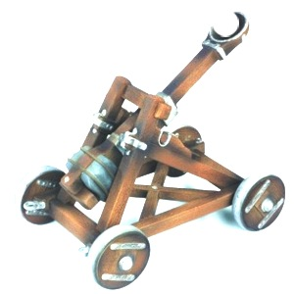








Career perspectives
Innovation management
Management consulting
Strategic consulting
Product management
Marketing
Starting your own
venture
Start-up scene
Venture capital
and investment
And all other jobs
where an entrepre-
neurial mindset
and strong innovation capabilities matter!

Slide 34

^^
Thank you for your attention and we look forward to seeing you soon at the next E&I Touchdown!

