Slide 1
SBWL Marketing and Consumer Research
Monika Koller
m.core - Institute for Marketing & Consumer Research
January 2024

Slide 2
Marketing and Consumer Research
You are interested in human beings?
In their role as consumers?
How they behave and why they show a certain behavior?
How they feel and experience emotions?
How this knowledge translates into applied marketing?
Join us at

Slide 3
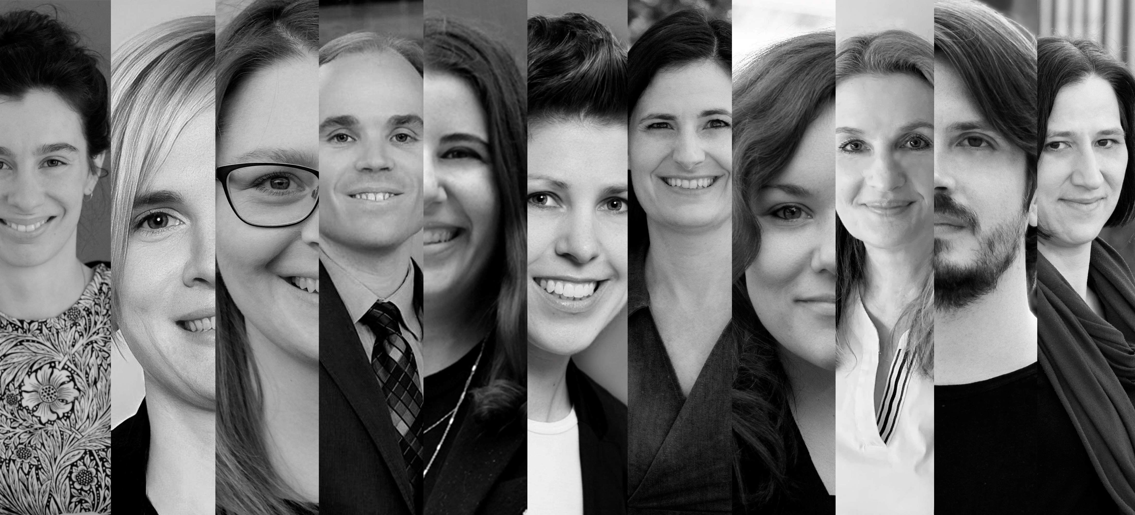
Meet the team

Slide 4
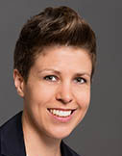
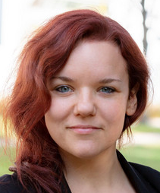
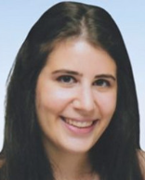
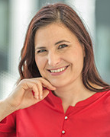
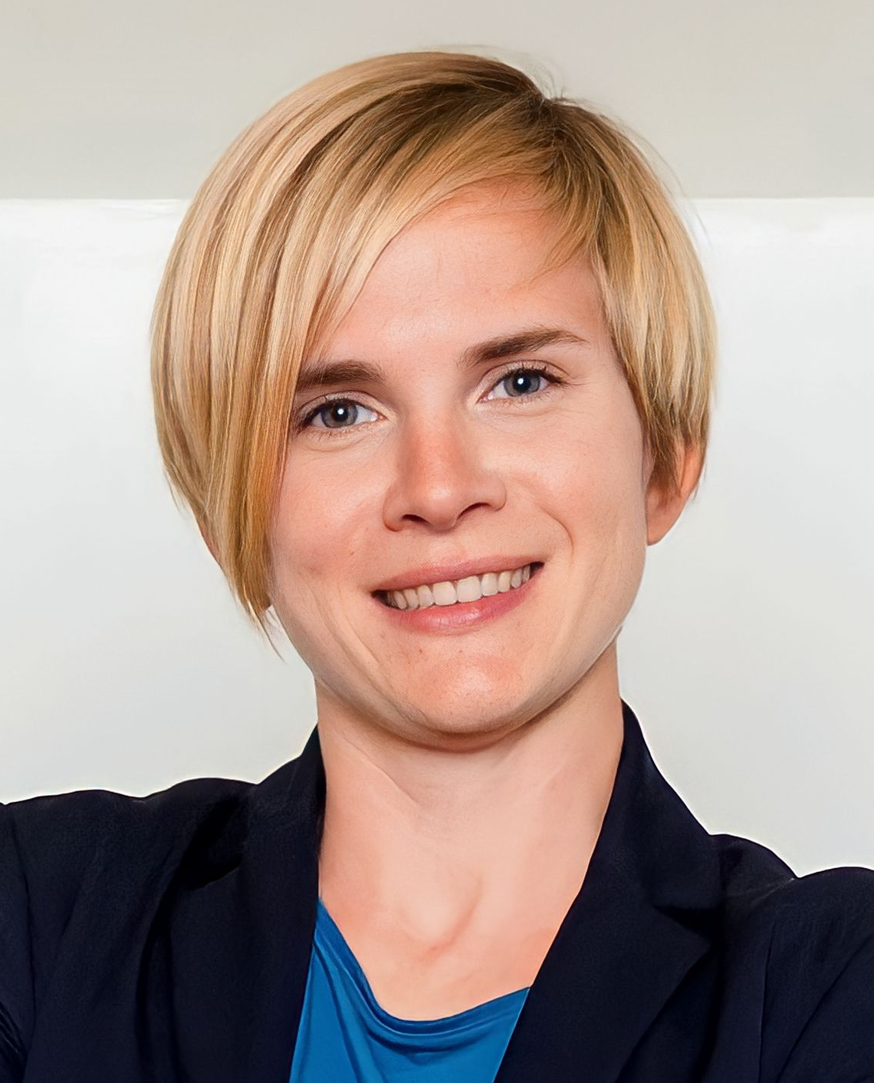
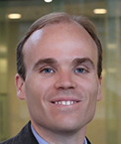
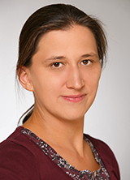
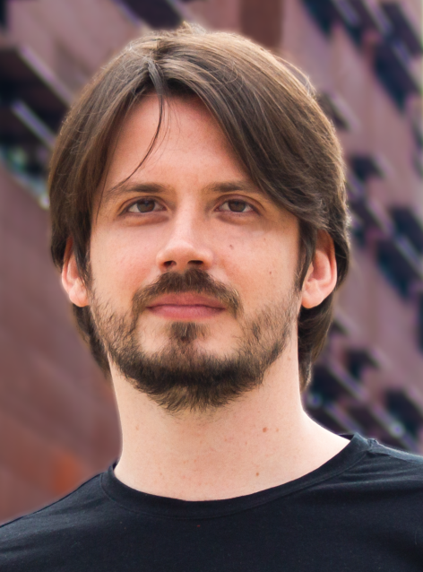
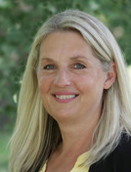
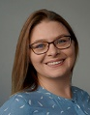
Meet the team
PD Dr. Monika Koller
Head of Institute
Associate Professor
Dr. Barbara Hartl
Assistant Professor
Burçak Baş, PhD
Assistant Professor
Univ. Prof. DDr. Bernadette Kamleitner
Deputy Head of Institute
Dr. Eva Marckhgott
Assistant Professor
John Price, MBA MSc
Teaching and Research Associate
Mag. Gerlinde Spicko
Senior Scientist
Susanne Ruckelshausen, MSc
Teaching and Research Associate
Till Bieg, MSc, MSc
Teaching and Research Associate
Helga Karl
Office Management
Linda Keller, BA
Office Management
Curiosity, reflection, and respect guide all our actions: as experts, researchers, teachers, partners and colleagues.

Slide 5
Your benefits
Insights on the psychology of human consumption behavior
Strong consumer orientation
Timeless knowledge
Customer touchpoints and experience management, Branding
Content based on up-to-date international consumer and marketing research

Slide 6
Your benefits

Slide 7
Your benefits
Insights on the psychology of human consumption behavior
Strong consumer orientation
Timeless knowledge
Customer touchpoints and experience management
Content based on up-to-date international consumer and marketing research
Relevance and real-world application

Slide 8
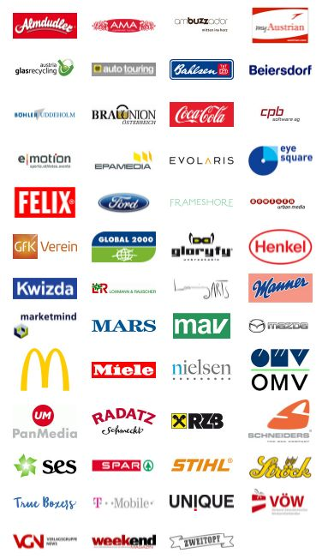
Your benefits

Slide 9
Your benefits
Insights on the psychology of human consumption behavior
Strong consumer orientation
Timeless knowledge
Customer touchpoints and experience management
Content based on up-to-date international consumer and marketing research
Relevance and real-world application
Personal support
Working in teams
Courses in English
Encompassing knowledge for professional career or any related master‘s program

Slide 10
Our expectations
Curiosity
Commitment
Critical and strategical thinking
Team spirit
Being ready to work on real-life cases and challenges
Interest in top-level academic research and empirical work
Open-mindedness and interest in studying relevant topics of our contemporary society, such as sustainable consumption behavior, privacy issues and ethical concerns

Slide 11
Admission
is looking forward to meeting you!

Slide 12
Ready to apply?
Admission to our SBWL is composed of three parts:
A motivation letter
Reflection task: Your individual reflection on a current topic in marketing and consumer research
Success in your previous courses (transcript of records)
1
2
3

Slide 13
Admission: (1) Motivation letter
Why are you interested to study at m.core and why should you be considered for one of the 45 spots available?
You also have the opportunity to add further information that you think might be relevant, such as professional experience as well as your personal interests. It is beneficial if you can prove this, e.g., with certificates, etc.
The motivation letter should answer the following questions:
Why did you choose the SBWL?
What qualifies you for the SBWL?
How did you achieve these qualifications?

Slide 14
Admission: (2) Reflection task: Your individual reflection on a current topic in marketing and consumer research
This short reflection directly relates to current topics that we will work on in the specialization. You can show your approach on elaborating and reflecting on relevant topics. It is very brief, about 300 words.
An example what the task could look like:
AI is currently all over the media, especially consumer applications such as ChatGPT.
What do you think about this new emerging topic?
From a consumers’ perspective?
Regarding its role in marketing?
In your answer you can, e.g., relate to examples you came across, reflect on them, state pros and cons from your individual perspective. Please cite any sources you have used.

Slide 15
Application process
Step 1 | Registration - eVVZ | Register for the course “Access to Specialization: Marketing and Consumer Research “.
Step 2 | Uploading of documents on canvas | If you have successfully registered for the course, you can find all respective documents and information on canvas, as soon as the applications are open. Submission of your application is open for one week.
Step 3 | Decision on admission | After applications are closed, we will examine all applications submitted via Canvas WU, and inform you shortly after whether you have been accepted to the Marketing and Consumer Research specialization.
Winter Term 2024:
Step 1: Registration via LPIS: February 1st until February 5th, 2024
Step 2: Application via Canvas is open from February 6th until February 13th, 2024
We are looking forward to your application and wish you luck!

Slide 16
Courses

Slide 17
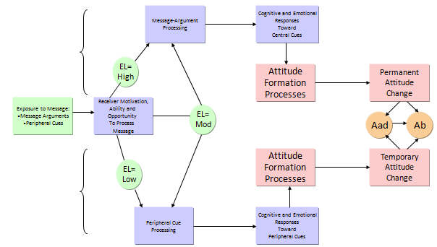
Course 1 Consumer Psychology and Behavior
“Understanding the human being as consumer”
Consumer Psychology
Sustainable behavior
Decision making processes
Course 1 is a platform to reflect on how this knowledge translates into
customer insights in real consumption situations and marketing decision-making.
Notes:
Fundamentals of consumer psychology

Slide 18
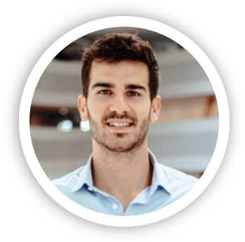
Course 1 Consumer Psychology and Behavior
"For me, the choice of a suitable specialization was very easy, as my interests lay in both psychology and marketing. These two components were perfectly combined in the institute and gifted me with a skill set that I can use very well in the further stage of life. Understanding the behavior of people and a basic understanding of psychology are in my opinion essential to create a good and successful working environment. The knowledge I learned, and the choice of this institute definitely gave me the chance to complete my MBA in the United States and will continue to give me a lot of pleasure, for which I am very grateful." Niels Buurman, MBA, Digital Projects Specialist, Red Bull Media House

Slide 19
Course 2 Consumer Touchpoint Management
“Insights about the most important touchpoints are vital. They enable a company to provide value to its customers and create customer experience.”
Touchpoints along the customer journey
Brand management
Communication

Slide 20
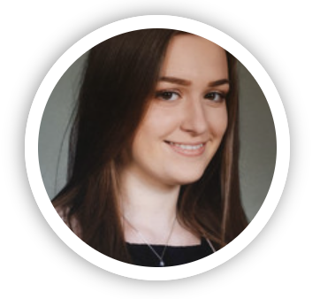
Course 2 Consumer Touchpoint Management
"I enrolled in the Sbwl Marketing and Consumer Research in WS21/22, and during that time I had the pleasure to take part in the course „Consumer Touchpoint Management“. During that course, I learned about brand strategies, a brand's image, and different communication channels.
I particularly liked that we could bring these strategies to life in a group project. On top of that, each of us got to work with Canva to create different posts and/or videos and get knowledge about how to create a post that e.g. brings a brand's image to life. I also gained important insights from professionals, who practice these strategies in their daily lives, during guest lectures.
In a nutshell, the Sbwl is very interactive with a nice teaching style. Therefore, I can highly recommend this Sbwl for all creative people, who are interested in Consumer Marketing." Katharina Spiller, Student at WU Vienna

Slide 21
Course 3 – Research Methods in Marketing
“Analytical thinking skills, knowledge on the identification of research questions, formulating hypotheses, operationalizing ways to test them and drawing conclusions based on the analysis of the results is vital for every marketing manager.”
Marketing research process
Overview on big data, AI and machine learning
Quantitative
Methods
Qualitative methods
Customer Insights
You will learn how to synthesize data into actionable customer insights.

Slide 22
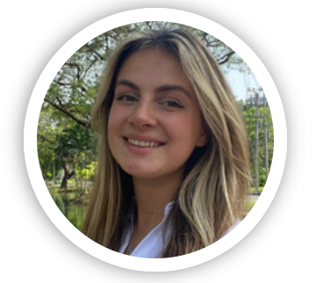
Course 3 – Research Methods in Marketing
"During WS 22/23 I took the 3rd course of the specialization MCORE which is about Research Methods in Marketing. The course helped me gain a general understanding of the different approaches in the marketing research field. Theoretical as well as practical learning methods, like group works and discussions, helped provide insights on when to use which methods and how to apply them in real life.
As a result, we learned for example how to formulate research questions and how to answer them with tools like excel. After completing the course, I felt like I learned new skills that will help my in my future career."
Leonie Beier, Student at WU Vienna

Slide 23
Course 4 – Marketing and Consumer Research Project
“In this course, generating customer insights is trained along real-world problems in marketing practice.”
Consumer behavior in relation to terry cloth (Winter 2023/24)
Social Economy: online platform re-use products (Winter 2021/22)
Consumer behavior in community gardens (Summer 2021)
Market potential for EDWIN (Winter 2020/21)
Customer Feedback (Summer 2020)
Perceived customer value, Customer segmentation,
Brand positioning (Summer 2019, 2017 and 2013)
Usage and optimization of promotional merchandise
(Winter 2018/19 and 2016/17)
Innovative Teaching Award 2023
https://youtu.be/cCOs8ZmUFrI

Slide 24
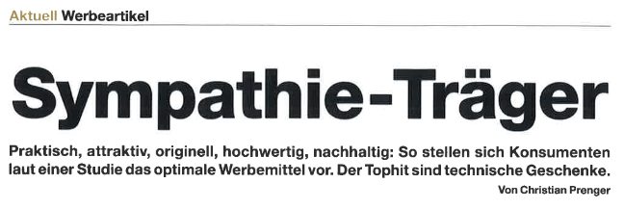
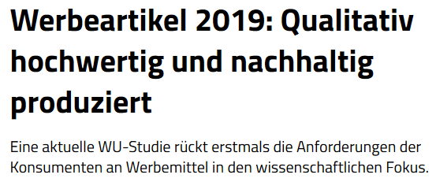
Course 4 Marketing and Consumer Research Project

Slide 25
Course 4 – Marketing and Consumer Research Project
"I did the “Marketing and Consumer Research Project” course as part of the M.CORE specialization in the WS 2022/23 and it is exactly what its name says.
In our project, we were tasked with conducting customer research in collaboration with Vöslauer to identify the big non-alcoholic beverage trends that will shape the coming decade. We were guided through a real-life empirical study by knowledgeable and experienced lecturers who provided us with advice and support every step of the way.
The hands-on experience of how to conduct and present such research from start to finish gave me a practical understanding of generating customer insights, which I think is an invaluable skill for my future career." Bence Oláh, Student at WU Vienna

Slide 26
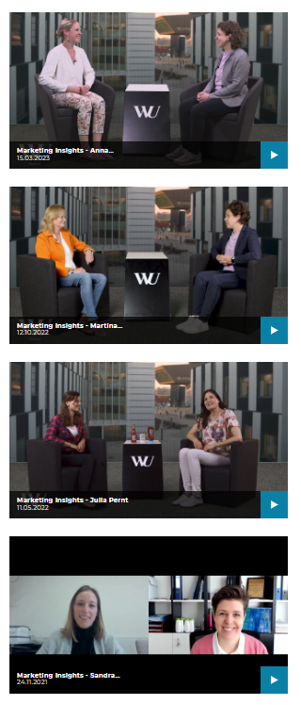
Course 5 – Marketing Insights
“This course allows insights into timely topics. It challenges students to apply their customer-centered knowledge to a broader context of real-world problems.”
Field-Trip & Real World Experience
Field-Trip & Workshop “The end of advertising as we know it”
Innovative Teaching Award 2021
https://youtu.be/2L4Mzd5kmMA
Nomination for the Ars Docendi – „Staatspreis für Exzellente Lehre“ 2022
As for course 5, alternatively to Marketing Insights, students
can choose from a pool of electives jointly offered with the other marketing specializations at our Department.
https://www.wu.ac.at/mcore/gesellschaft-praxis/marketing-insights-videos/

Slide 27
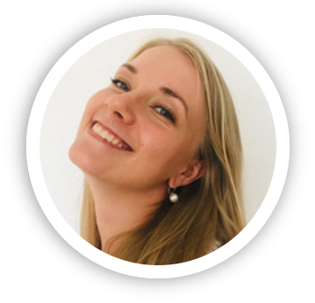
Course 5 – Marketing Insights
"Through the SBWL I got a great insight into different fields of marketing. I learned so much interesting things and thus found out in which direction my career path should go.
I'm very grateful for the real life experiences we got through the sessions with interesting leaders in the marketing sector. The best thing I could take away from the SBWL was the opportunity to get to know my current employer. The CEO of LOOP was presenting his company as well as his idea of storytelling and afterwards I got in contact with him.
Now I'm working at LOOP which I never regret and also got the idea for my bachelor thesis out of the session with him. I recommend this SBWL to everybody, who is interested in marketing basics, forward thinking marketing strategies, interesting companies."
Alexa-Sophie Harnisch, BSc, Loop Salzburg

Slide 28
Unique additional benefit: High Potential Award
Our best students get the chance to apply for a paid internship
Current partner:
https://www.wu.ac.at/en/mcore/teaching/bachelor/high-potential-award/

Slide 29
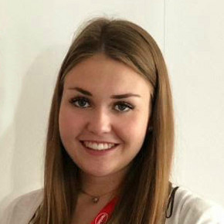
m.core High Potential Award winner 2017
Miriam Krusic, MSc
Key Account Manager Procter & Gamble in Switzerland
“I can only confirm that what you are learning during the five courses of the SBWL is incredibly valuable for your working life and will make it a lot easier to start a career in Marketing/Sales.
I could really apply a lot of theoretical knowledge during my internship and gain further practical experience during the courses. Thus, for everyone who is interested in Marketing I can only recommend the SBWL. The SBWL even enhanced my interest in the Marketing area and opened up ambitious perspectives to me.”

Slide 30
m.core Ambassadors

Slide 31
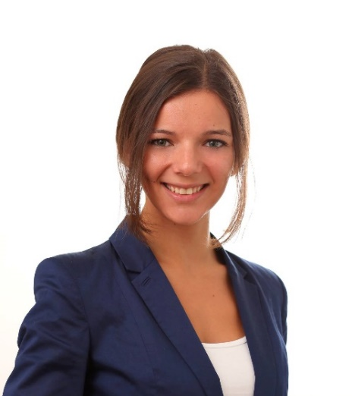
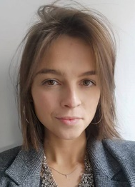
Voices of our Alumni
“(…) The mix of exams, seminar papers and projects with renowned project partners is a perfect preparation for both master programs and the start of a career. This adds to the attractiveness of this SBWL.“
“(…)The cooperation with prestige companies let me gather real-life experience, which I immediately can implement in new challenges. The expertise I gained from the specialization prepared me perfectly for the marketing world. I am now able to start right away in a position where I can make a real change and where my knowledge is highly valued."
Julia Müller-Pernt, MSc Senior International Group Brand Manager, Kotányi GmbH
Kristina Kuschnig, MSc
Marketing & PR Manager, myrobin

Slide 32
Student Ambassador 2024
If you want to expand your marketing knowledge and dive deeper into the field of consumer psychology, mcore is the perfect specialization for you!" Nina Gaßner, BSc, m.core Student Ambassador 2024
Fell free to contact Nina: nina.gassner@wu.ac.at

Slide 33
Voices of our Students
https://youtu.be/VJ9QhL7v0pA

Slide 34
Stay Tuned!

Slide 35
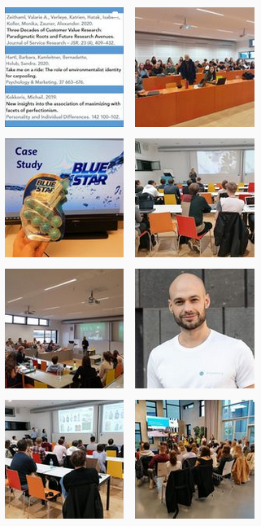
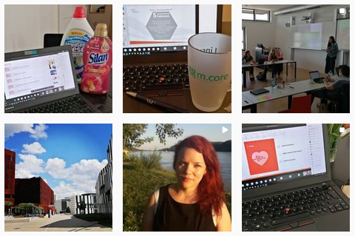
News
m.core Institute for Marketing and Consumer Research
mcore_wu
Institute for Marketing and Consumer Research

Slide 36
Is it a match?

Slide 39
We are looking forward to meeting you!
PD Dr. Monika Koller
Head of the Institute
Associate Professor
monika.koller@wu.ac.at
m.core - Institute for Marketing & Consumer Research
Welthandelsplatz 1, 1020 Vienna, Austria
Department of Marketing
T +43 (0)1 313 36-4613
mcore@wu.ac.at
wu.ac.at/mcore
FB /WU.mcore
IG @mcore_wu

