Slide 1
SBWL Digital Marketing
Prof. Dr. Nadia ABOU NABOUT
SBWL Messe Jan 2024

Slide 2
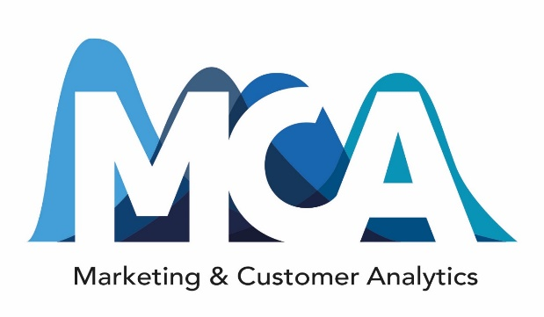

SBWL Digital Marketing
The Makeup
SBWL Service & Digital Marketing
Digital Marketing
wu.ac.at/mca
wu.ac.at/imsm

Slide 3
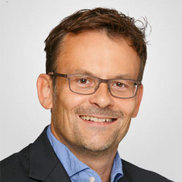
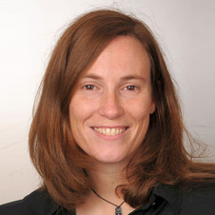
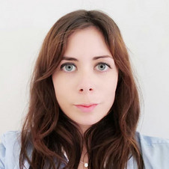
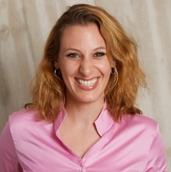
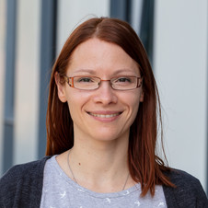

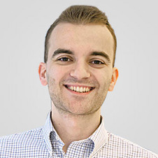
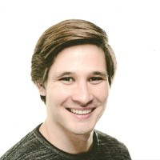
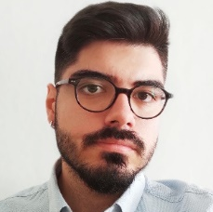
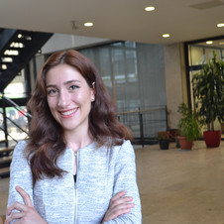
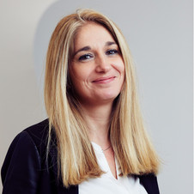


SBWL Digital Marketing
The Team
SBWL Service & Digital Marketing
Digital Marketing
wu.ac.at/mca
wu.ac.at/imsm

Slide 4
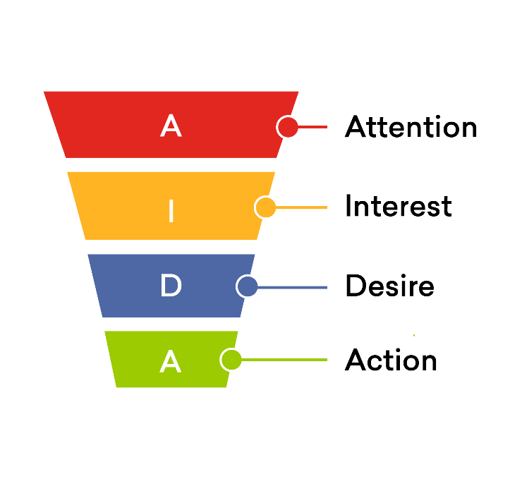
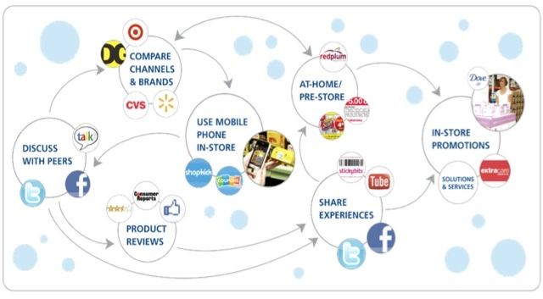
SBWL Digital Marketing
The Content
Digital transformation of the marketing landscape:
  Information technology and interactive online media change the way consumers collect information, make decisions, communicate with each other and with firms, …
„Classical“ marketing funnel:
Digital customer journey:
Luca Bruno / AP

Slide 5
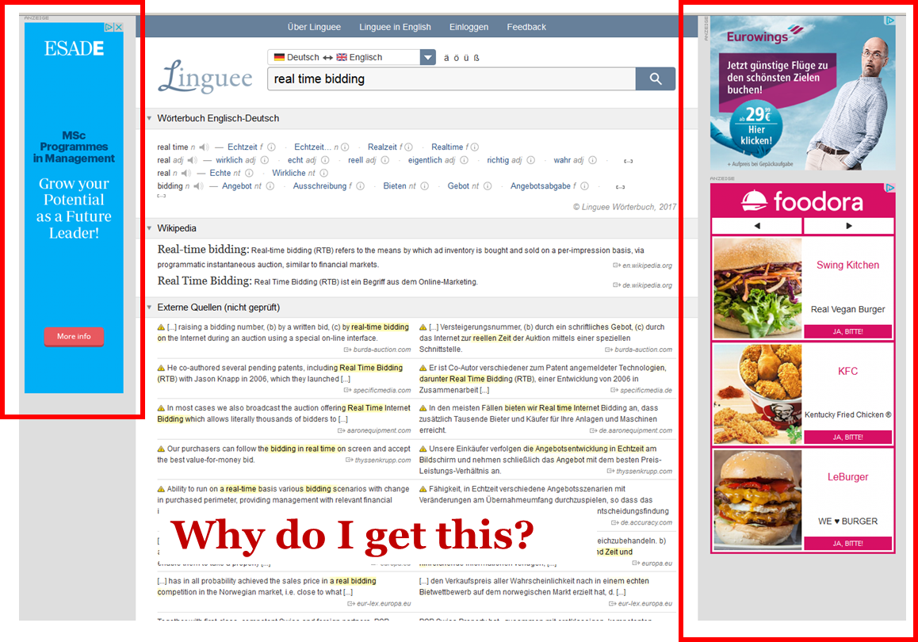
SBWL Digital Marketing
Let me explain: Technology changed/s the face of marketing
Online ad displays:

Slide 6
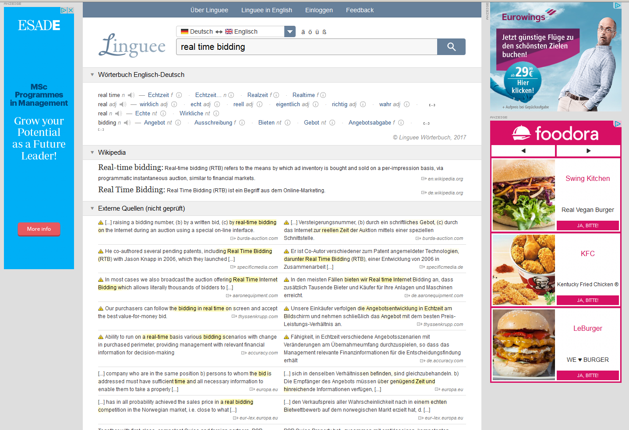
Online Advertising
Why do I get this?

Slide 7
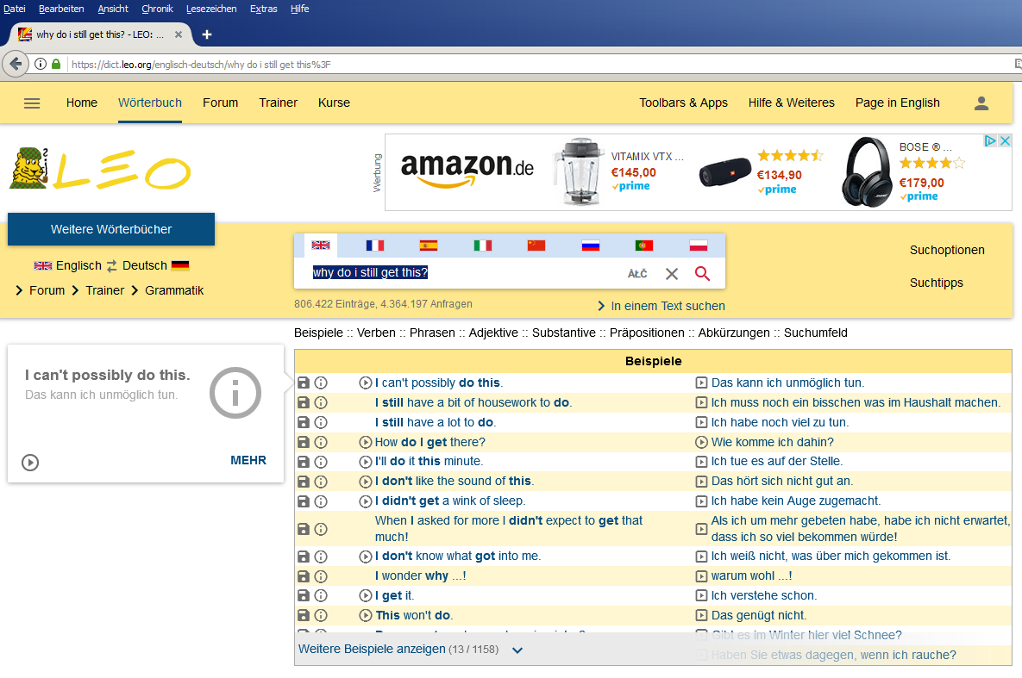

Online Advertising
… but why do I (still) get this?
Notes:
Eye tracking … is the process of measuring eye fixations of certain visual objects (e.g., advertising copies, shelf-spaces in the supermarket). An eye tracker is a device for measuring eye positions and eye movements.

Slide 8
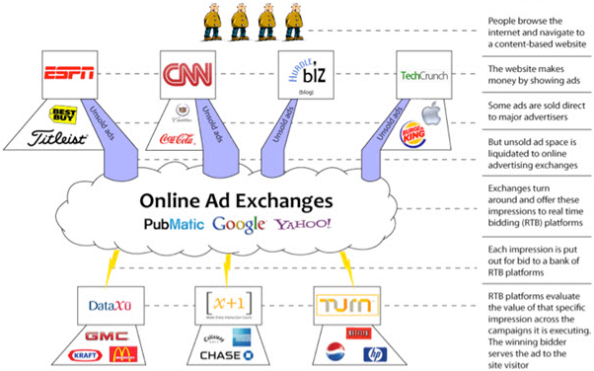
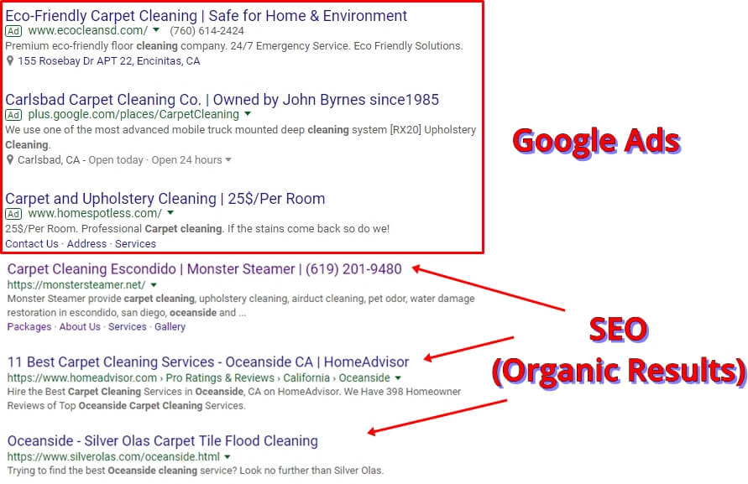
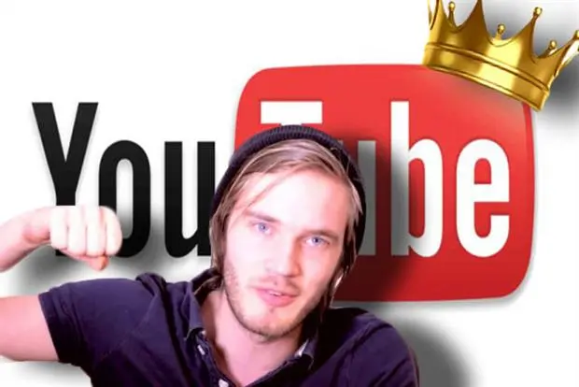
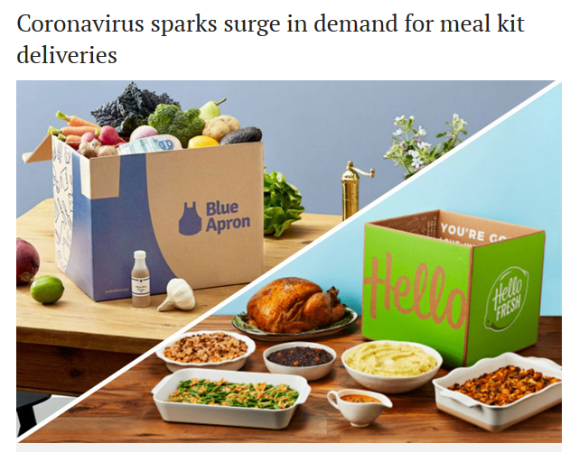


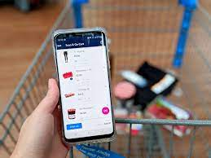
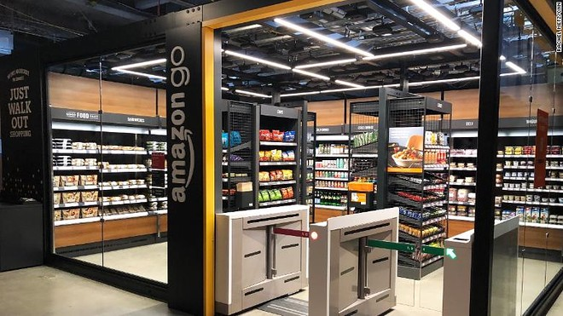
SBWL Digital Marketing
Let me explain: Technology changed/s the face of marketing
Online ad displays
Real-time ad bidding
SEO / SEA marketing
Influencer marketing
Subscription services
Omni-channel
>110mn followers
Notes:
PewDiePie >110mn YouTube followers
Quellen:
https://datatopics.worldbank.org/world-development-indicators/themes/economy.html, “Services, value added (% of GDP)” in 2018 [07.05.2021]
https://de.statista.com/statistik/daten/studie/295575/umfrage/beitrag-der-tourismus-und-freizeitwirtschaft-in-oesterreich-zum-bip/, Anteil des Tourismus in Österreich am BIP bis 2019 [07.05.2021]
https://de.statista.com/statistik/daten/studie/428467/umfrage/uebernachtungen-in-beherbergungsbetrieben-in-oesterreich/, Anzahl der Übernachtungen in Beherbergungsbetrieben in Österreich von 2009 bis 2019 (in Millionen) [07.05.2021]

Slide 9
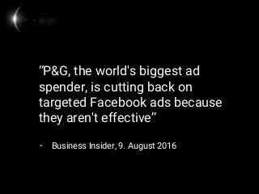

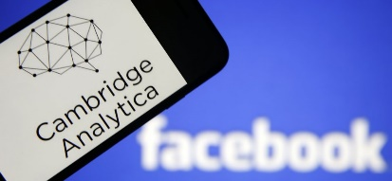



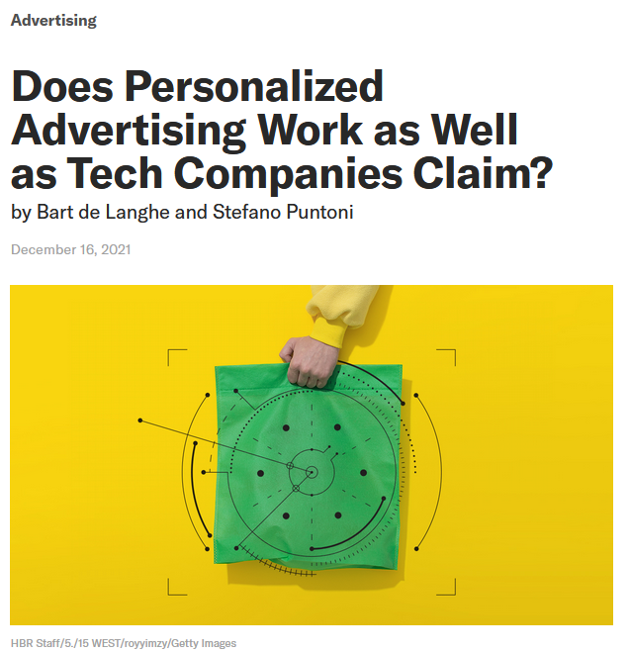

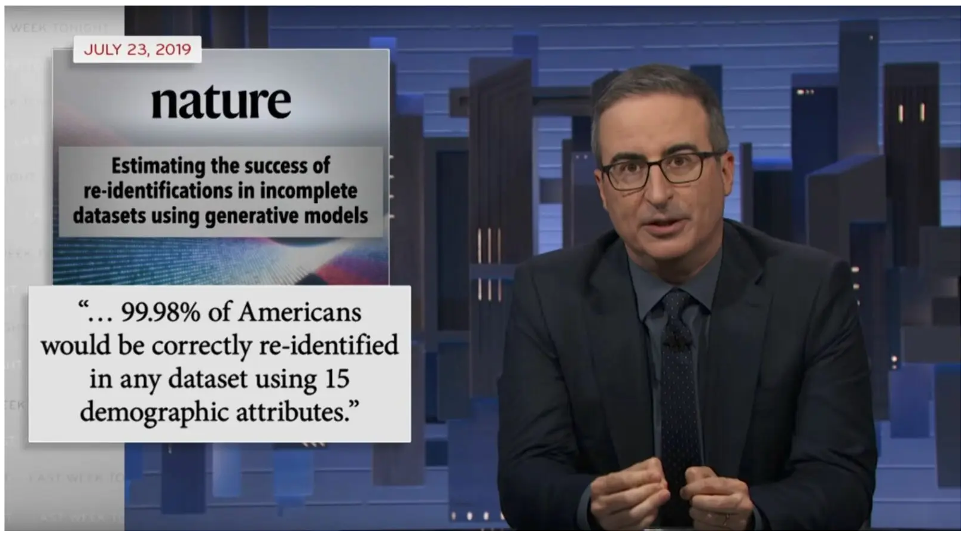
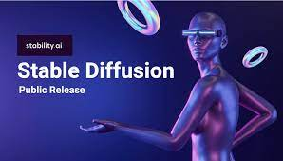
SBWL Digital Marketing
… but there are also doubts about its effectiveness
Ethics, Privacy, AI Accountability Concerns:
John Oliver
Notes:
PewDiePie >110mn YouTube followers
Quellen:
https://datatopics.worldbank.org/world-development-indicators/themes/economy.html, “Services, value added (% of GDP)” in 2018 [07.05.2021]
https://de.statista.com/statistik/daten/studie/295575/umfrage/beitrag-der-tourismus-und-freizeitwirtschaft-in-oesterreich-zum-bip/, Anteil des Tourismus in Österreich am BIP bis 2019 [07.05.2021]
https://de.statista.com/statistik/daten/studie/428467/umfrage/uebernachtungen-in-beherbergungsbetrieben-in-oesterreich/, Anzahl der Übernachtungen in Beherbergungsbetrieben in Österreich von 2009 bis 2019 (in Millionen) [07.05.2021]

Slide 10
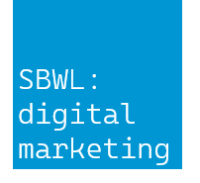
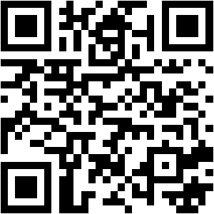
SBWL Digital Marketing
The Offer
Our specialization addresses the challenges in digital marketing and equips students with the skills necessary to succeed in such business environments!
We offer research-driven course content to develop / strengthen your:
Management Skills: Solving marketing related problems in a digitized economy
Analytical Skills: You acquire methodological knowhow to support marketing-decision making (“quantitative intuition”)
Transfer Skills: Apply and implement this knowledge in real-world decision scenarios (digital marketing lab)

Slide 11
SBWL Digital Marketing
The Structure
Future Managers in
Digital Marketing
Modul 1
Thesis (optional)
Bachelor Thesis at MCA or IMSM
Thesis (optional)
We offer ...
Research-driven course content
Training in first-rate tools for business analytics
Support to translate skills into business practice
Collaborations with industry partners
Modul 1
Lab
C3: Digital Marketing Lab (2. term)
Lab
Modul 1
Modul 1
Electives
Course E1 (2. term):
Elective 1
Course E2 (2. term):
Elective 2
Electives
Modul 1
Modul 1
Course C1 (1. term):
Digital Marketing
Course C2 (1. term):
Marketing Analytics
Core
Course C2 (1. term):
Marketing Analytics
Core
Marketing & Customer Analytics (MCA)
Interactive Marketing &
Social Media (IMSM)

Slide 12



SBWL Digital Marketing
The Lab
Opportunity to sharpen your transfer skills: Translate your acquired knowledge into concrete operational marketing plans!
You will work for one semester in close cooperation with our industry partners.
  Former industry partners:
  Next semester:
  & clients

Slide 13
. . .
SBWL Digital Marketing
The Electives
Managing Customer
Relationships
A Practical Guide to SEO and SEA Marketing
Online Content Marketing
Growing Companies with Google Ads and Analytics
Social Media Campaign Management
Influencer Marketing Campaign Management

Slide 14
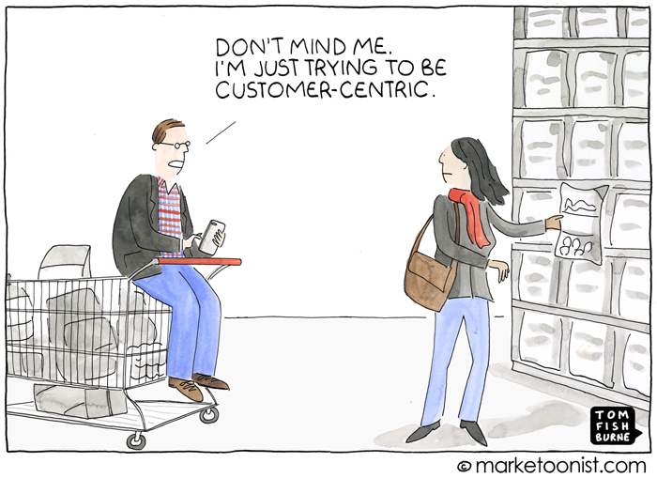
Customer centricity in a digital marketing context
SBWL Digital Marketing
The Electives: Managing Customer Relationships
Build and shape the relationships with the right customers.
Who should we serve?
How long will they stay?
What makes them happy?
Why should we serve them?
When should we target them?
When should we NOT target them?

Slide 15

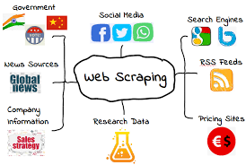
SBWL Digital Marketing
The Electives: Online Content Marketing
Automatic Segmentation
Feedback Analysis
Big Data – Dimensionality Reduction
Sentiment Analysis
Product Review Comparative Analysis
Summarization
Automatization

Slide 16

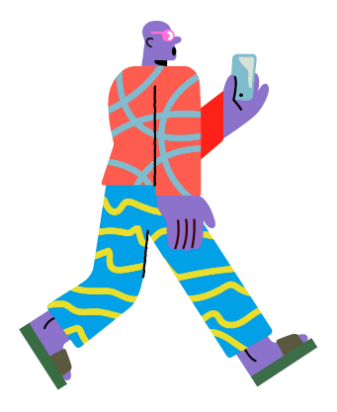


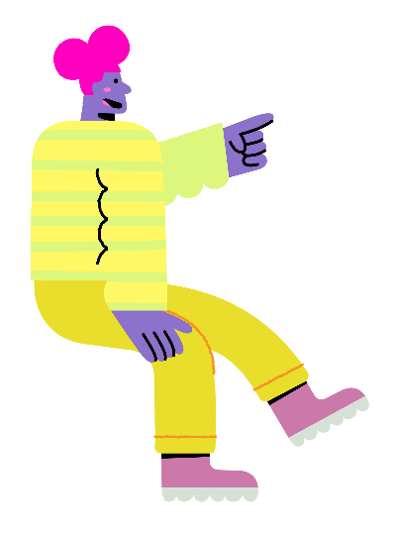











SBWL Digital Marketing
The Electives: Social Media Campaign Management
objectives & KPIs
target groups
competitive analysis
content strategy
tracking and optimizing

Slide 17
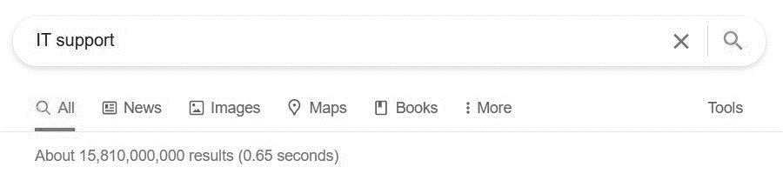
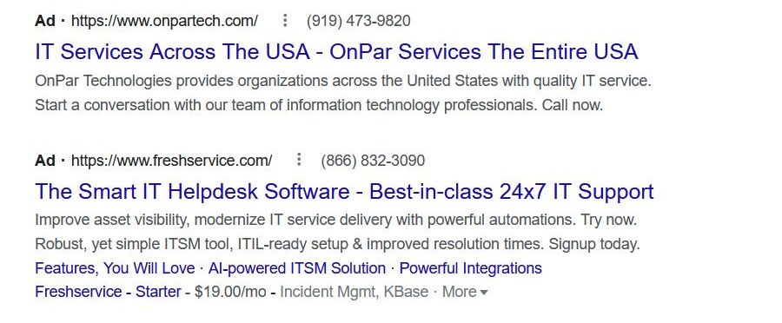
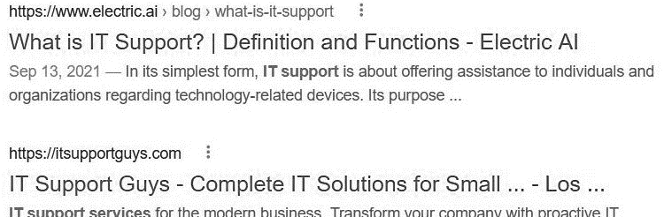





SBWL Digital Marketing
The Electives: A Practical Guide to SEO and SEA Marketing
Foundations
  Technical SEO
  Content generation and optimization
  Ad optimization
Quantitative SEO & SEA Techniques
  KPIs, statistical methods, A/B testing and experimentation
  Analytical machine learning
  Generative SEO/SEA Content using LLMs
Practical applications
πηχ

Slide 18



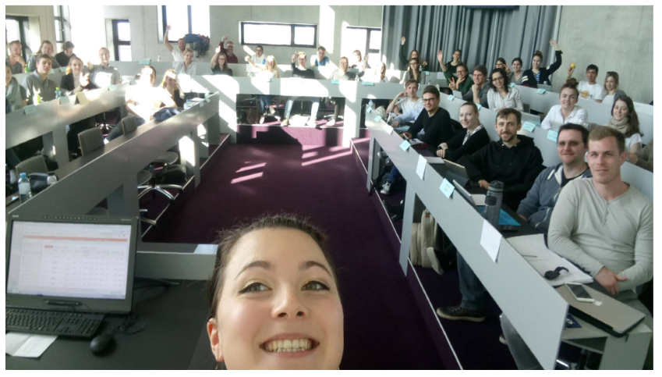
SBWL Digital Marketing
The Electives: Growing Companies with Google Ads & Analytics
  What You’ll Discover:
  Up-to-date & practical knowledge about Google Ads campaigns
  How to set up your first campaigns in Google Ads
  Everything you need to know to take the Google Ads Certificate at the end of the course (bonus part of your grade)
  Important basics of Google Analytics
  Insights and tips from running a global marketing agency with 2000+ worldwide clients from many different industries

Slide 19


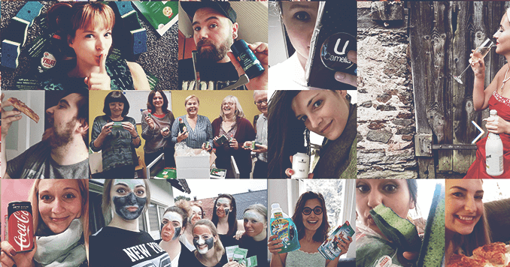
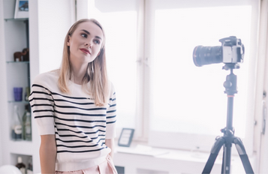





SBWL Digital Marketing
The Electives: Influencer Marketing Campaign Management
In theory…
So…
What makes people talk?
How to utilize this?
How to set up influencer campaigns?
And integrate them to the marketing mix?
Notes:
Based on following assumptions:
There are associative or semantic networks, e.g. build by marketing activity of focal and competing brands
They are closely related so that activation of one can trigger the other
Information within the networks is relevant for a decision at hand e.g., to buy or not to buy one of the respective brands

Slide 20
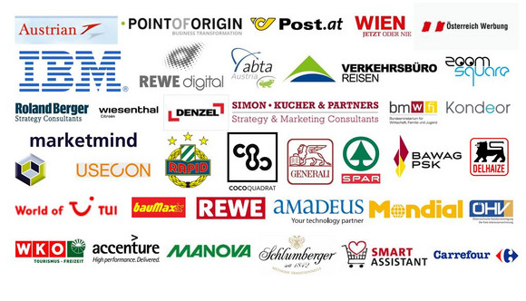












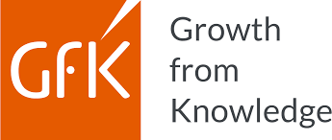







Corporate Partners:
SBWL Digital Marketing
The Impact
Spin-Offs & Start-Ups:
Many of our graduates are founders, C-level executives in tech-startups, partners in consulting firms, …:
Sila Ada (Head of Data Analytics at Payla Financial Services)
Thomas Haller (Senior Partner at Simon-Kucher & Partners)
Nicolas March (CEO of Vathos AI Vision for Industrial Robots)
Michael Platzer (Co-Founder & CSO @ MOSTLY AI)
Holger Sicking (Head of Research & Data Analytics at Ö-Werbung)

Slide 21
SBWL Digital Marketing
The Action
Admission Process:
Get ready for your application NOW … ☺
Step 0
Obtain information about the program:
(a) DM webpage, (b) MCA & IMSM institute sites (c) ÖH SBWL info & Messe, (d) LinkedIn posts, …
Step 1
Register at LPIS for course „Access to Specialization Digital Marketing“ (Nadine Schröder)
Step 2
Complete submission form and digital marketing skills check on CANVAS „Access to Specialization Digital Marketing“
Step 3
We examine your application documents submitted via CANVAS & inform you shortly after about your admission using your WU email address
01-02-2024 – 04-02-2024
02-02-2024 – 05-02-2024
beginning
12-02-2024
Notes:
Application Documents: 3 Skills + short motivation letter
Step 2: One day later than corresponding step 1: because learn often needs 1 day or so to get updated
Allgemeine Daten über Ihre Person
Personal data
Success in your previous courses (transcript of records)
Gradings: all gradings from STEOP and CBK (we consider 45 slots)
(currently) no entrance exam

Slide 22
We look forward to your application and wish you good luck!
SBWL Digital Marketing
short.wu.ac.at/digitalmarketing
digital.marketing@wu.ac.at
www.wu.ac.at/mca
www.wu.ac.at/imsm

