Slide 1
SBWL International Business
SBWL Presentation
Dr. Evelyn Reithofer, Hannah Brückler & Rita Eigl

Slide 2
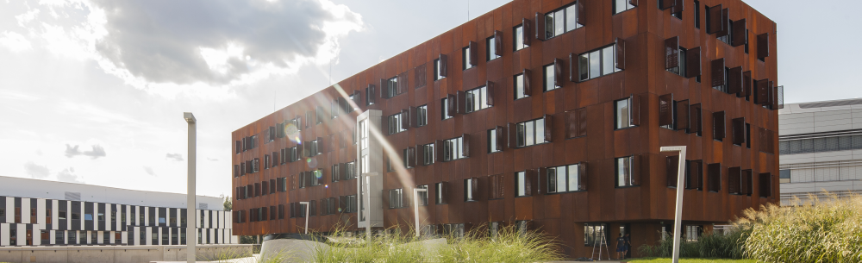
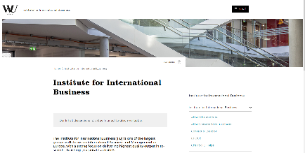
Institute for International Business: where to find us
Where are we?
https://www.wu.ac.at/iib/iib/studies/sbwl

Slide 3
The SBWL International Business aims to provide an understanding of relevant resources, markets, and strategies in IB
What do we offer?
1
Academic excellence:
International strategies, markets, and resources across functions
2
Real world application:
Intense interactions with the corporate world
3
The „IIB-Experience“:
Small groups, varying class formats, motivated faculty
4
The IB Club:
Events, networking and talks organized for IB students

Slide 4
Graduates continue their career in a wide range of positions, usually in an international environment
What do alumni do?
1
1
Active in graduate programs, specifically CEMS, ExInt
2
Marketing/ finance/ strategy/ HR in internationally active firms
2
3
Internationalization management
3
4
Founders/ GMs of (global) start-ups
4

Slide 5
The SBWL International Business consists of the following courses and is entirely taught in English
Courses
1. Semester
Course1:
Foundations of International Business
Theoretical and Strategic Foundations of IB
Course 2:
International Business Applications
Applications of IB Theories, Strategies, and Functions
2./3. Semester
Course 3:
Strategies
e.g. Strategies of EMNE, International Energy Strategies (with OMV)
Course 4:
Markets
e.g. International M&A, International Marketing, Internationalization in Professional Soccer
Course 5:
Resources
e.g. International HRM, Global Leadership, Financial Resources and Internationalization

Slide 6
Students can choose to specialize even further in one of three tracks
Courses
1. Semester
Course 1 & 2
2./3. Semester
The SBWL International Business Central Europe Connect Track
@WU: Strategies & Management in Central Europe (strategies)
@EUBA Bratislava: Structural Dynamics in Central Europe (markets)
@SGH Warsaw: Marketing Resources and Consumer Behavior in Central Europe (resources)
The SBWL International Business Sustainability and Corporate Responsibility Track
Strategies with Aspects of Sustainability/Responsibility/Ethics
Markets with Aspects of sustainability/responsibility/ethics
Resources with Aspects of Sustainability/Responsibility/Ethics
The SBWL International Business SME Internationalization Track
International Strategies for SME
International Markets and SME
Resources and SME Internationalization

Slide 7
Cooperation with one of our partners
Courses
‘Real Life’ Experience
Many of our courses are organized jointly with industry partners to allow for real life experiences and intense interaction with industry partners.

Slide 8
SBWL International Business students should be excellent, open minded, and cross-functionally interested
Who are we looking for?
1
Students with excellent academic background
2
Students with international curiosity
3
Students with cross- functional abilities

Slide 10
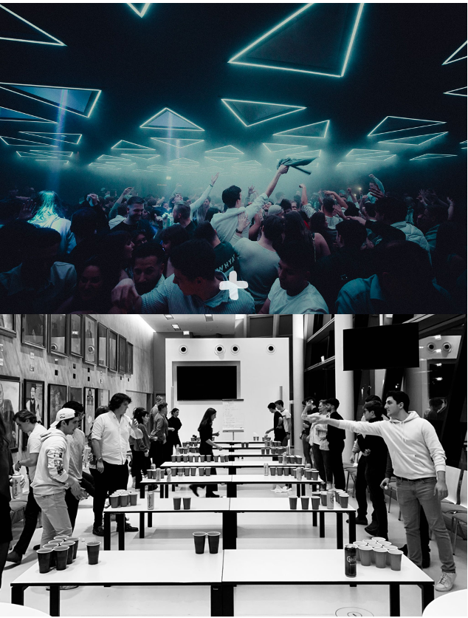
EVENTS @ IB CLUB
Corporate events: with REWE, Accenture, BCG, WWF and others.
Social events: meet@Christmasmarket
Beerpong Championship
Cooperation with PLUS at Babenberger Passage
Strong IB community and IB faculty
CEMS and SIMC Talk

Slide 11
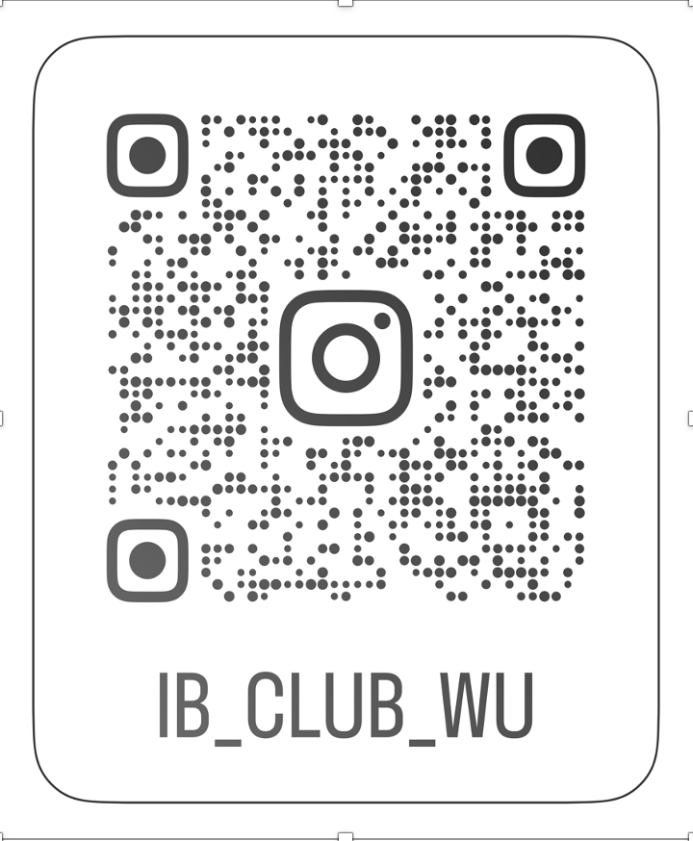
JOIN US ON INSTAGRAM

Slide 12
Each semester we select students based on a combination of two different approaches
Entry into the SBWL
Summer 2024 about 160 students
50%
Average of the best 27 ECTS (Bachelor level)
50%
Entry exam (multiple-choice)

Slide 13
Supervision of Bachelor or Master Thesis
What else is possible?
Assignment
Twice every semester (March, June, October, December) we publish a list of thesis topics for which students can apply
Procedure
In case you have a specific topic you would like to supervise or have a student who is interested in writing a thesis with you, do not hesitate to contact sbwlib@wu.ac.at.

Slide 14
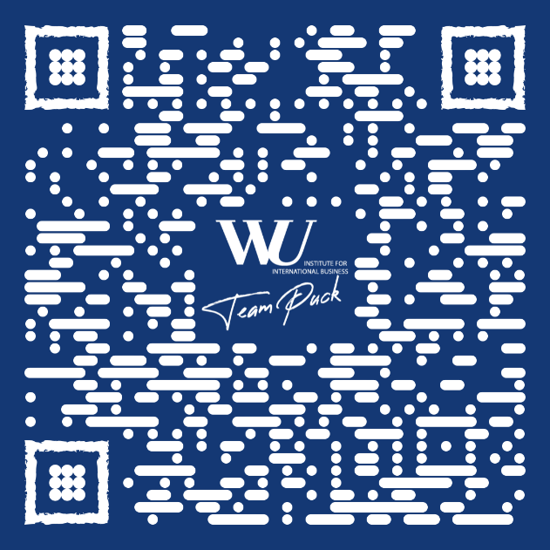
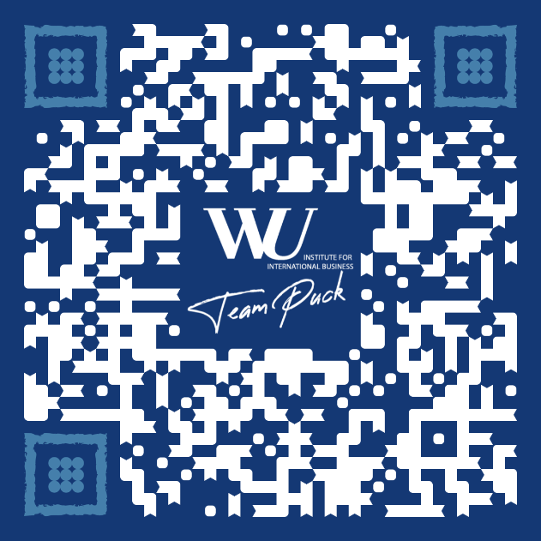
International Business Team Puck: follow us
Where are we?

