Slide 1
International Business Communication (SIBC)
Specialization
Department of Business Communication

Slide 2
Major aspects of SIBC
Communicative competence & strategic language use
Communication skills
Theories and concepts of language and communication
Business communication in various settings
Development of (English) language skills
Research-based teaching and practical application

Slide 3
Course modules & sample topics covered
I
II
III
IV
V
  Foundations of (business) communication
  communicating power,
  identity and persuasiveness
  Recruitment, change management, conflict management
  corporate culture, diversity, sustainability management
  Dealing with (international) stakeholders
  crisis communication, corporate social responsibility
  digital business discourse & strategic use of social media
  How does culture influence interactions?
  cross-cultural advertising, recruitment practices, multilingualism
  Application of acquired knowledge
  production of audience-specific communication in smaller groups
Key Concepts
Internal BC
External BC
Intercultural BC
Skills

Slide 4
Recommended schedule (2 semesters)
Internal BC
Skills
Key Concepts
External BC
Inter-cultural BC
Successful completion is a requirement for all other courses

Slide 5

"What may it help me with?"
Corporate communication and related areas, especially in international organizations
Leadership positions and job profiles with management responsibilities in Austrian and international organizations
Excellent match with a wide range of other specializations such as
  Marketing
  Management
  even Intl. Accounting and Controlling
Possible headstart for Department's own master's program in Business Communication

Slide 6
SIBC is for you if you are:
…interested in how business communication works in international contexts
…eager to learn how corporations use language as a tool to achieve their communicative goals
…willing and able to work with language
…keen on practicing those skills

Slide 7
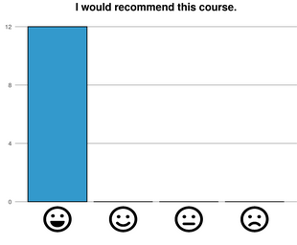
What your peers are saying about SIBC:
Key Concepts (Course I):
"loved…the interactive elements of the lecture"
"…it encompasses many interesting theoretical concepts of linguistics but feels more practical in its application in business than other social sciences"
External Business Communication (Course III):
"The contents are just very relevant and prevalent. Started my new job at the same time as this course and it is eye-opening, how many of the concepts are also found in real work life."
Skills for International Business Communication (Course V)
"I especially liked that the whole course was really about practical applications of business communication and that many examples were given."
"…each session was building up on creating the final presentation and I think there will be a lot of skills I will apply in the future."

Slide 8
Application process for SS25
60 students per semester
first-come, first-served; with restrictions:
  half the slots reserved for students with a grade of “Very Good” on BaWiSo19 CBK class IBC (also possible for BBE students)
  rest (and any unfilled slots from above) goes to students in order of registration
Changes to admission process starting in WS25 will be announced in spring 2025

Slide 9
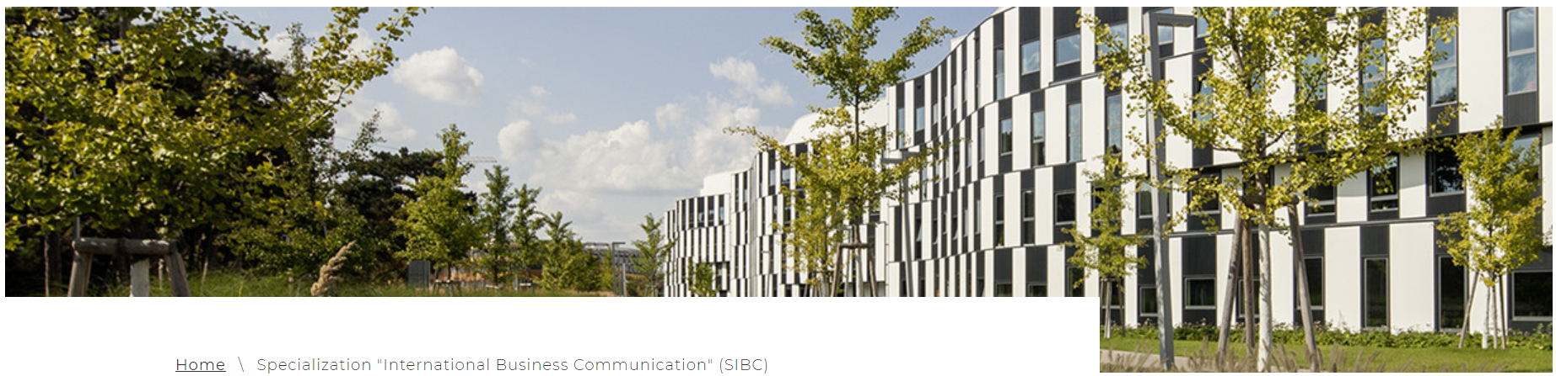
Curious?
You can find more information on
the Specialization’s website
Still got questions? Contact bizcomm@wu.ac.at

Slide 10
Thanks/Danke/Grazie/Gracias/дякую/Спасибо/Merci
We look forward to welcoming you to our Specialization "International Business Communication" in the near future!

