Slide 2
Who

Slide 3
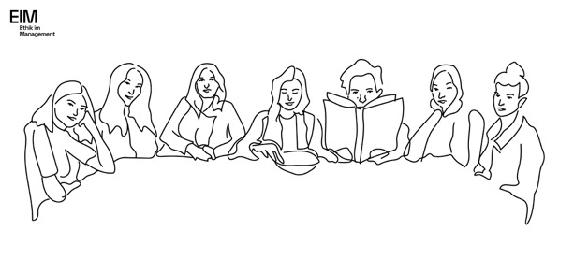

Slide 4
Why

Slide 6
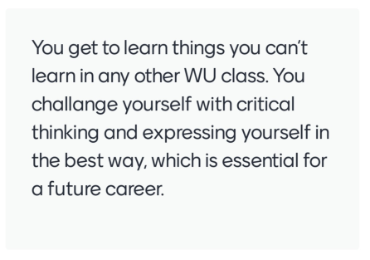
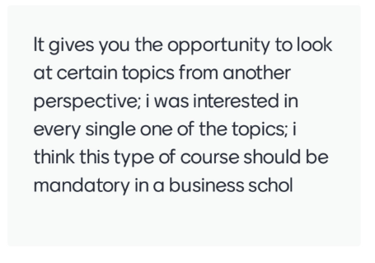
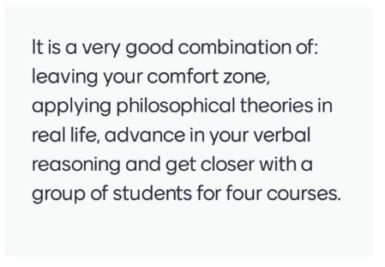

Slide 7
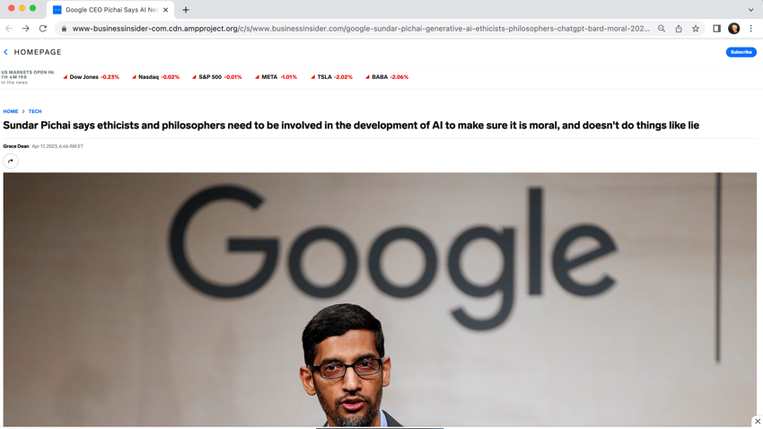
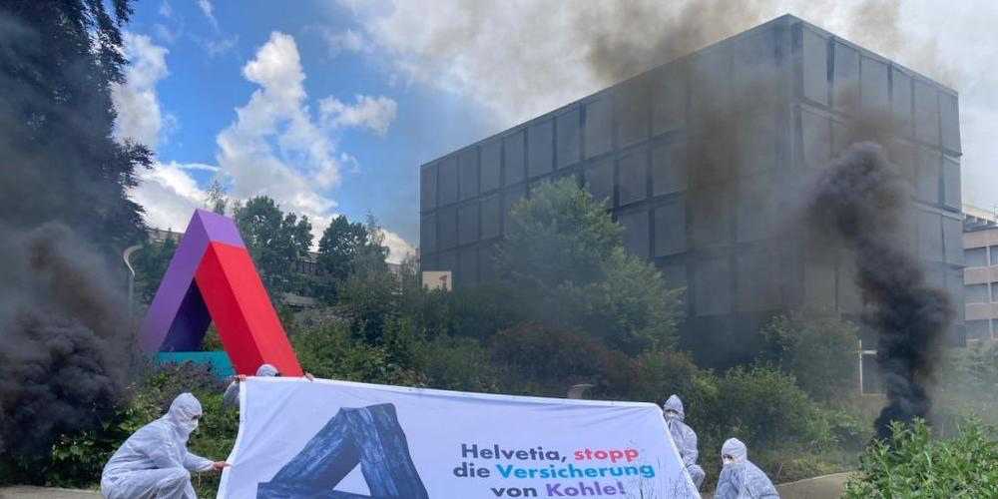

Slide 9
What

Slide 10
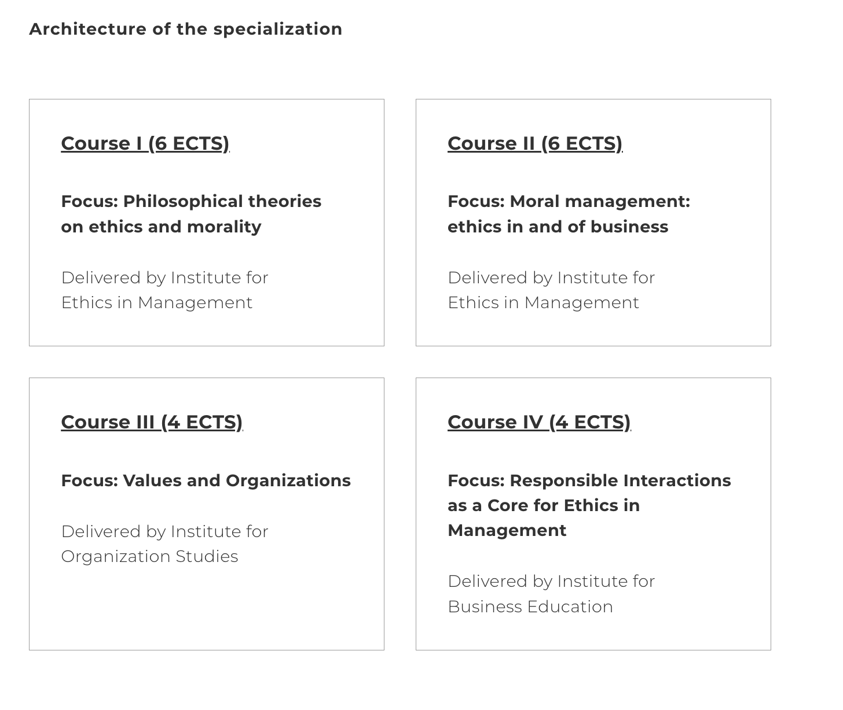

Slide 11
How

Slide 12
Tools for thinking
Thinking out loud
Vocabulary
Ideas
Borealis Ethics Challenge, December 2023
Repertoire
Impact
Working out loud
Experimentation, application, translation

Slide 13
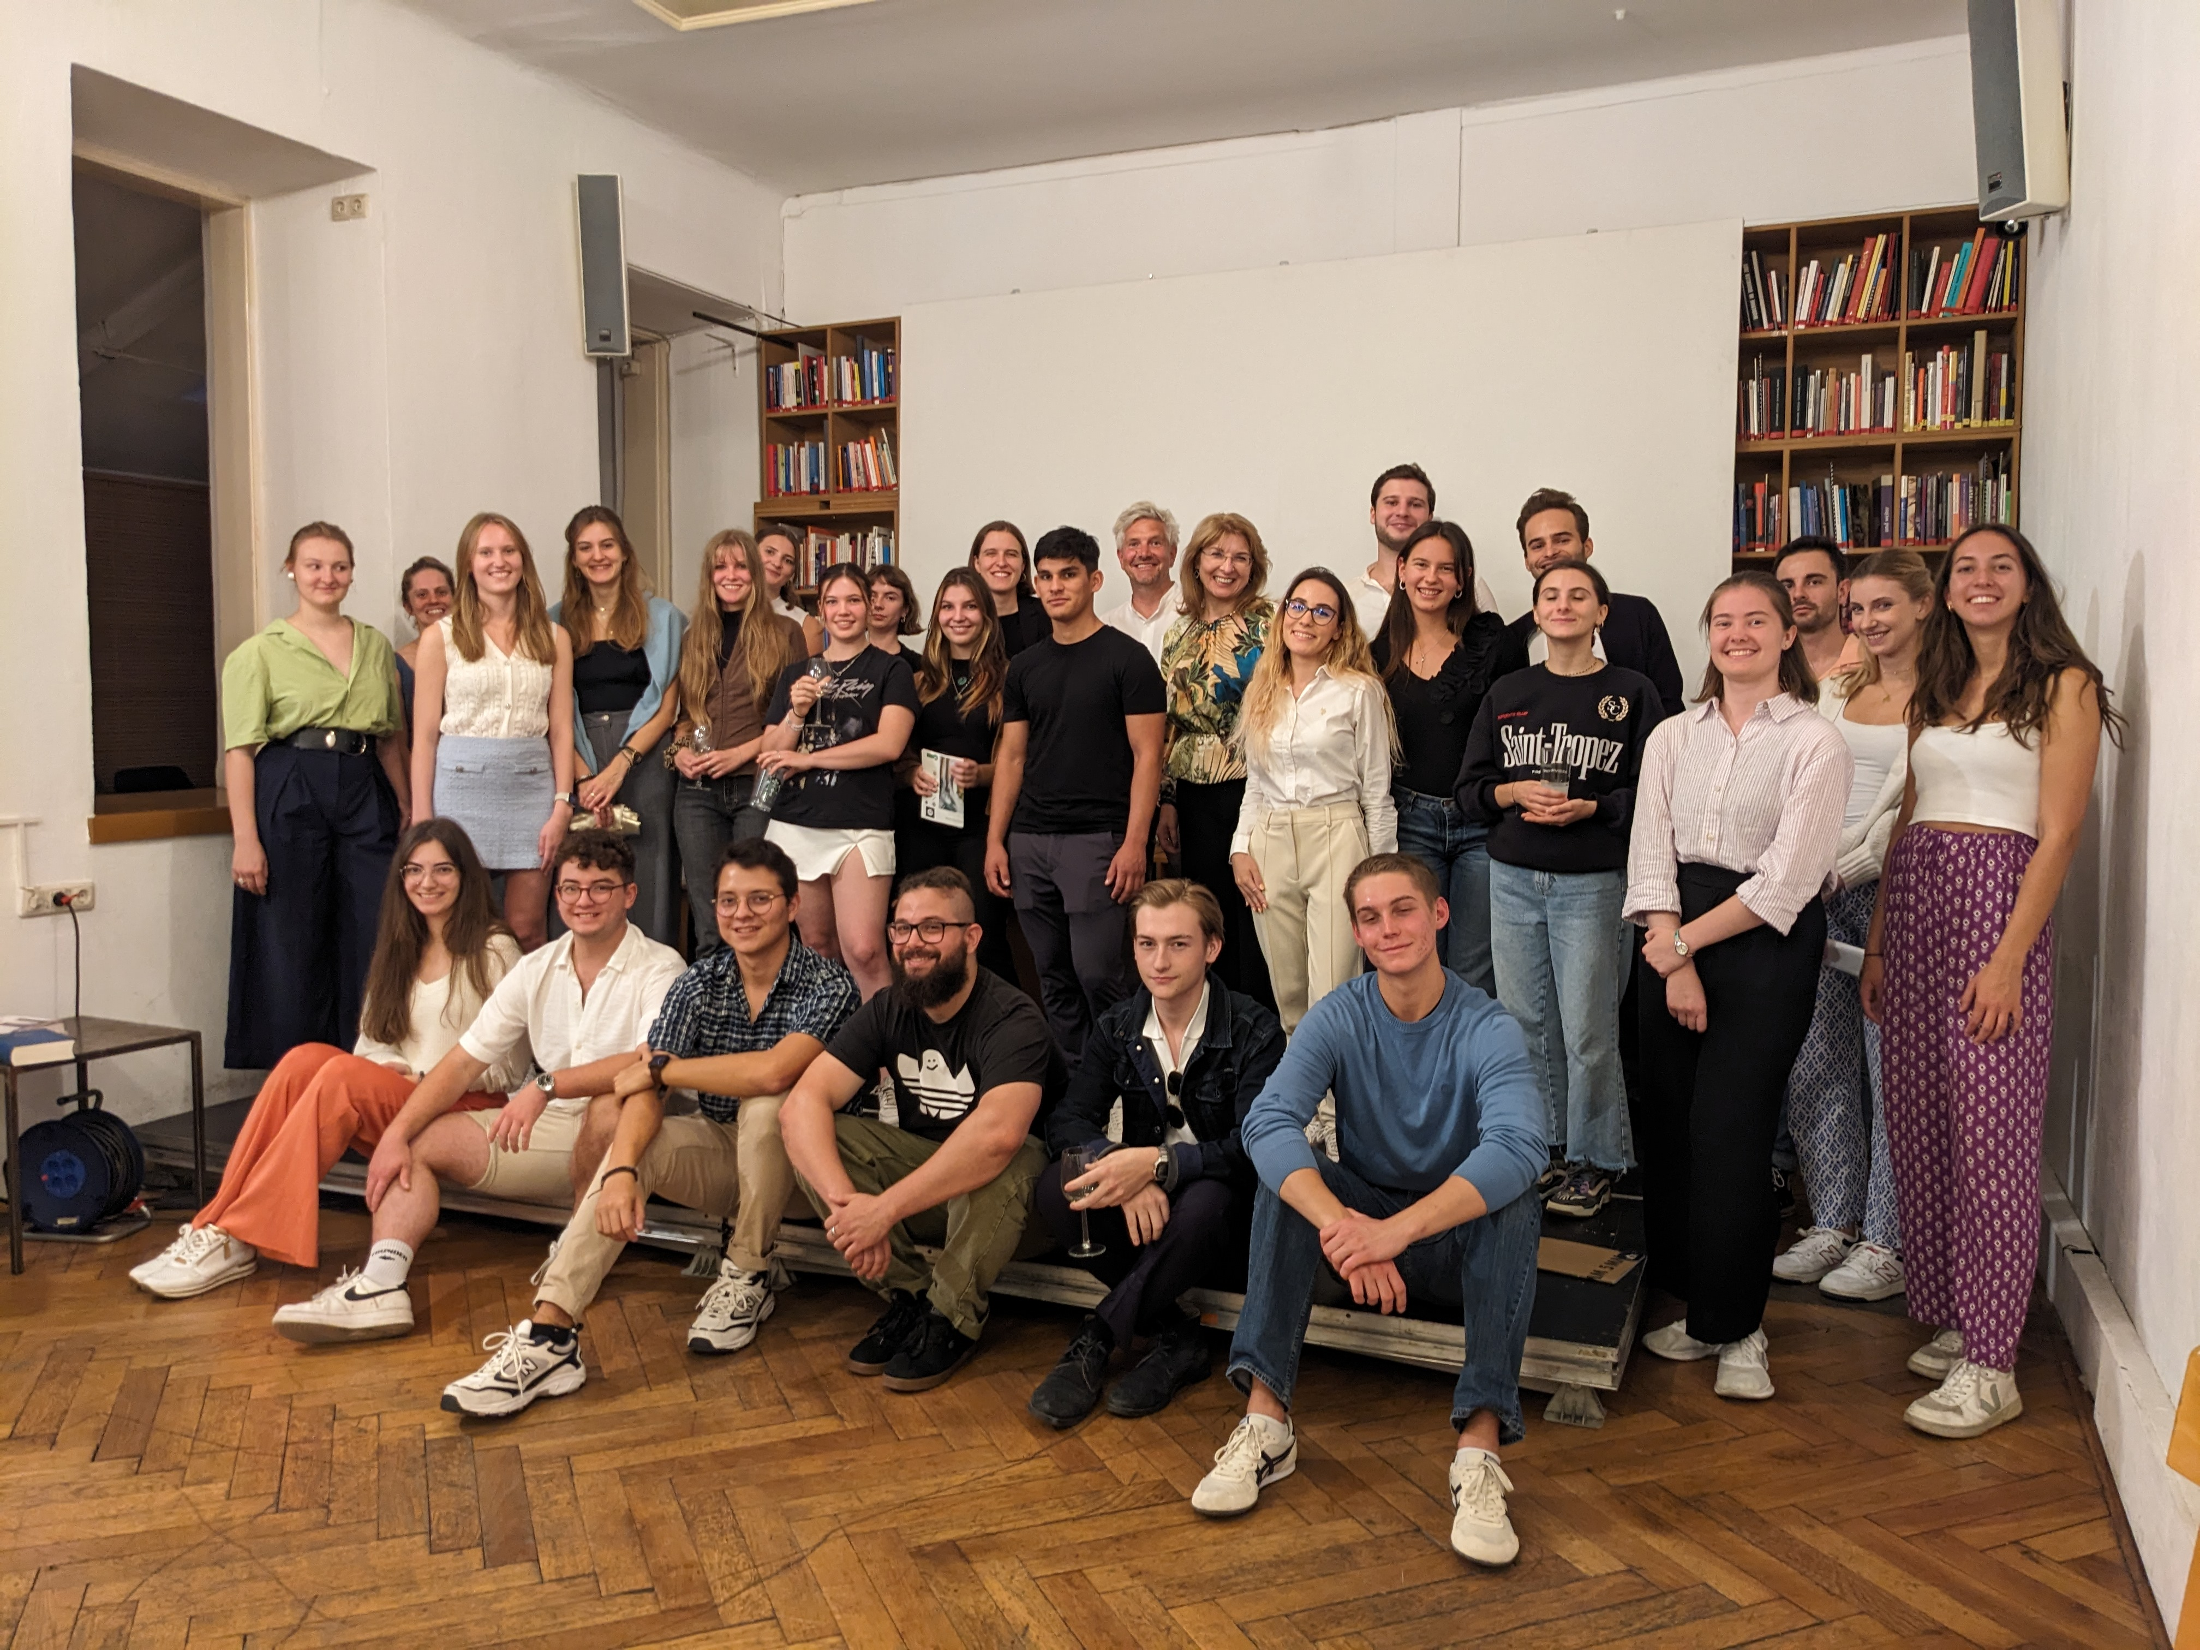
Launch Event SBWL, September 2023 at The Depot

Slide 14
Questions?

