Slide 1
SBWL Information Management & Control
Dr. Everist Limaj
(Assistant Professor and Coordinator of the Specialization)
Notes:
1

Slide 2
SBWL Information Management & Control
Focus: Management of Information Systems (IS)
in a highly digitalized business environment
  How to govern IS and provide strategy alignment?
  How to manage the selection and development of IS?
  How to optimize IS operations and manage related risks?
The lectures are …
  … very current and future-oriented in particular serving the on-going business digitalization and transformation trends
  … research-led and also highly relevant for practice
  … enriched by presentations from business managers and SBWL alumni

Slide 3
What we offer …
(… or why you should chose this specialization)
  Advanced management abilities AND a profound knowledge of Information Systems (IS) in a corporate environment
  Assessment and optimization of performance of (selected) IS-related processes and projects
  Applicable knowledge concerning the evaluation and control of IS in companies
  The ability to develop and analyse (even) new and innovative approaches in digitalization of business processes

Slide 4
… what you should bring with you
(… or how well the specialization fits your interests)
  Passion for contemporary technologies in a corporate environment
  Interest for corporate challenges and how they can be addressed and managed with the help an of Information Systems (IS)
  Being open-minded for new and innovative IS solutions
  Interest in analytical and structured management approaches
  The urge to trigger a well-founded and highly relevant career path dealing with management issues of business digitalization

Slide 5
Typical Jobs for Alumni
IS/IT Manager
IS/IT Service Manager
IT/Information Security Manager
IT Project Manager
Information/IT Quality Manager
IT Auditor
IT Risk Manager
IT Change and Innovation Manager
IT Strategist
IT Consultant
IT Decision Maker

Slide 6
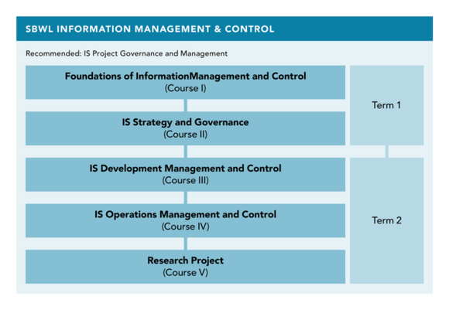
SBWL - Structure
Semester 1
Semester 2

Slide 7
Course 1 - Foundations of Information Management and Control
Goal:
Achieve a basic understanding concerning the most important information systems used in a business context as well as roles related to IT in companies
Content:
Develop a basic understanding concerning current information technology (IT) and IS/IT services
Corporate Software Systems on different organizational levels as well as Operating Systems
Common roles in the IT department
Social issues of information systems

Slide 8
Course 2 – IS Strategy and Governance
Goal:
Understand what an IS strategy is and how it is used to generate value. Be able to design and interpret selected IS strategy performance models
Content:
IS strategy & governance principles & processes based on IT Infrastructure Library (ITIL) & COBIT 5
Organizational requirements
Challenges, risks, and critical success factors
Frameworks and methodologies including valuation and selection, as well as performance optimization

Slide 9
Course 3 - IS Development Management and Control
Goal:
Develop an understanding towards managing the purchase and/or development of innovative IS services
Content:
IS/IT processes of IS purchase and development (based on IT Infrastructure Library - ITIL)
Performance and software metrics
IS/IT investments: cost-benefits assessments, purchase and development risks
(Open) IS/IT innovation

Slide 10
Course 4 - IS Operations Management and Control
Goal:
Develop a profound understanding on operational management of Information Systems in companies
Content:
IS/IT Service Management: processes, functions, frameworks, standards (ITIL, ISO/IEC 20000, CMMI-SVC …)
IS/IT Systems Management (Technical Management): Processes, function, frameworks (TOGAF, FCAPS, ISO/IEC 2700n …)
Relevance and application in companies

Slide 11

Course 5
Research Seminar
Final course
Different topics (to fit your interests)
Preparation for future research projects (e.g., Bachelor thesis)

Slide 12
SBWL IMC
Facts & Figures
Per semester / term
  30 students
  Duration (min.): 2 semesters
  Every course at least 1x per semester
  Courses in English
    Reason: English is the world-wide language in information systems. In addition, to qualify for the Information Systems Master at WU, you have to verify IT-related courses in English (see http://www.wu.ac.at/programs/en/master/is)
    „PI“ for all courses
Acceptance of students based on average grades
(ranking of all successfully completed ECTS)

Slide 13
Requirements
For the German speaking bachelor programs, successful completion of:
  STEOP
  Accounting and Management Control 1 & 2
  Business Information Systems 1
  Private Business Law 1
  StatisticsI
For the English speaking bachelor program, successful completion of:
  STEOP
  At least 42 ECTS Credits of the main program phase except the "Academic Skills".
10 out of the available 30 places will be preferably given to students, which have already completed at least one course of the major 'Business Information Systems' (Wirtschaftsinformatik).

Slide 14
Admission Process
You register for ET 5226 (Access to Specialization in Business Administration: Information Management and Control)
We inform the best 30 students within two work days after the end of the registration phase
Accepted students register for course 1 of our SBWL (Foundations of Information Management and Control)
If there are places left after the PI registration phase, all remaining students will have the chance to directly register for the introductory PI (first come first serve)

Slide 15
Important Dates
The important dates for summer semester 2024 are as follows:
Registration phase (ET 5226)
01.02.2024 (14:00) - 07.02.2024 (23:59)
Notification of acceptance (via email)
09.02.2024
Registration phase for accepted students (PI 4605)
22.02.2024 (14:00) - 25.02.2024 (23:59)
If free places available (first come first serve):
Second registration phase for students on the waiting list (PI 4605)
28.02.2024 (starting at 14:00)-08.03.2024 (23:59)
First unit of introductory course 1 (PI 4605)
11.03.2024 (12:30 – 17:30 online)

Slide 16
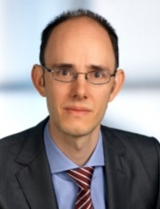

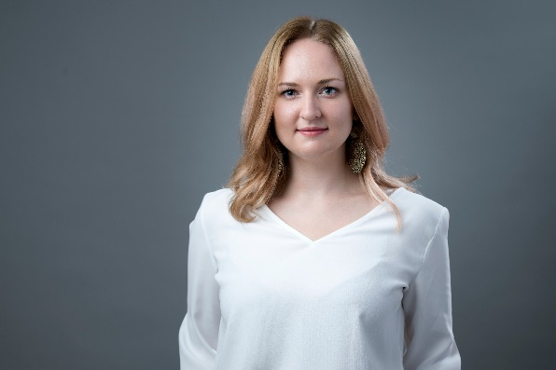
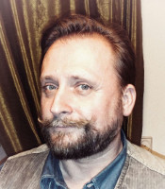
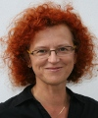
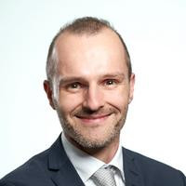
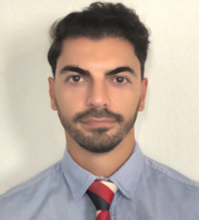

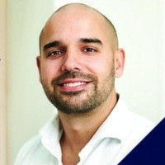
Who we are …
 | Prof. Dr. Edward Bernroider (Chair of Institute) |  | Peter Virag (Responsible for admission process) |  | MSc. Anita Neumannova (Teaching and Research Associate)
 | ao. Univ.Prof. DDr. Roman Brandtweiner (Vice-Chair of Department) |  | Dr. Josef Kolbitsch (CIO, WU) |  | Prof. Dr. Barbara Krumay (University of Linz)
 | Dr. Everist Limaj (SBWL Co-ordinator) |  | Prof. Dr. Nikolaus Obwegeser (Berner Fachhochschule, Switzerland) |  | BSc. MA, Barbara Unger (Senior Consultant & Project Manager)

Slide 17
Bachelor Thesis
After finishing the specialization (SBWL)
Different topics
  Related to the topics of the members of the institute
  Please contact the members of the institutes directly
  You can even suggest a topic you are interested in
Process
  Contact via mail – providing a possible topic (1 page description)
  First meeting & feedback
  Submit proposal based on feedback(approx. 5 pages)
  Acceptance or rejection
  Finish your Bachelor thesis within 1 semester

Slide 18
Practitioner Talk & Informal Get-Together
For students in the specialization we organize different events
„Practitioner Talk“
  Different topics presented by our business partners and Alumni
Get-together after the talk
    Platform for exchanging information with students of other semesters / alumni

Slide 19
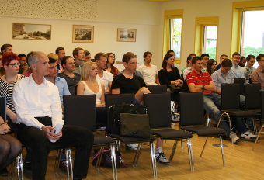
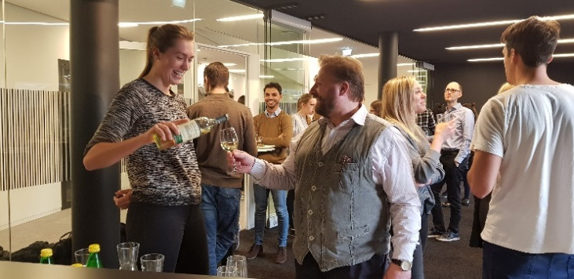
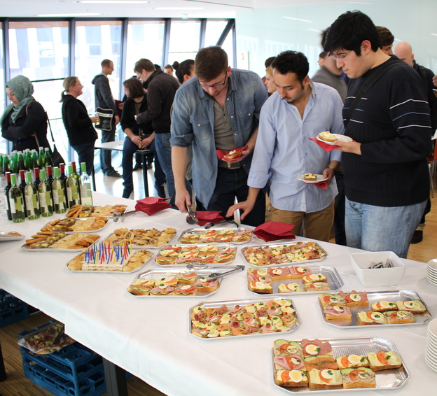
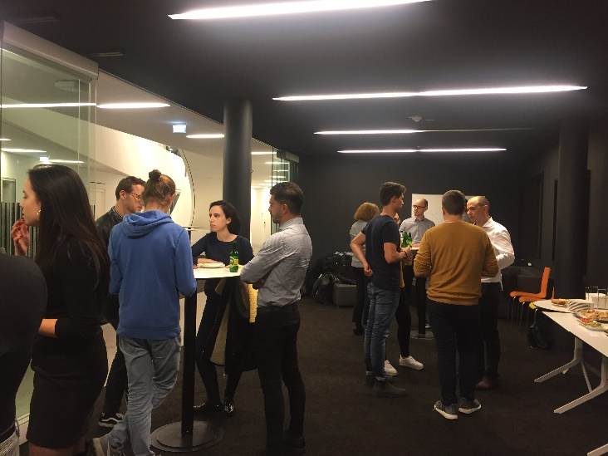
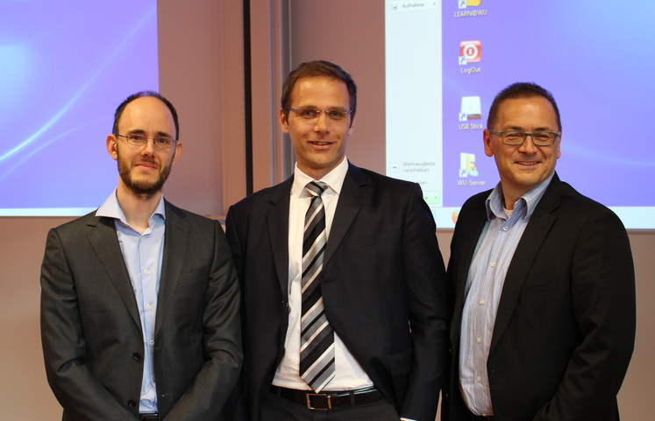
Impressions

Slide 20
















Business Partners
(Excerpt)

Slide 21
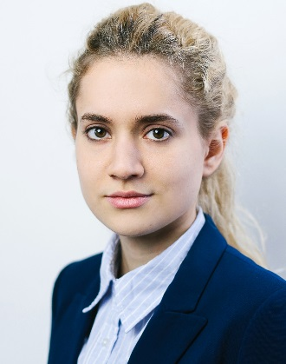
Testimonials
Maja Pavlovic
MSc: Imperial College London (offer from LSE) / Internship: Deutsche Bank
“My experience with the Institute for Information Management and Control is that of a highly supportive and collaborative environment. Several group projects with students and the inherent discussions of relevant literature not only deepen one’s theoretical knowledge but also train invaluable soft skills. Having gained a more profound understanding of innovation management of information systems development has already helped me at my current work experience at the Deutsche Bank’s Digital Factory. Overall, the institute’s instructors provided fast and high quality support throughout the whole specialisation (e.g. single queries, group projects, seminar papers and bachelor thesis). Above all, Prof. Bernroider’s supervision of my seminar and bachelor theses, and tremendous support during my Master applications enabled me to secure MSc offers for the London School of Economics (LSE), Imperial College London and an interview with University College London (UCL).”

Slide 22

Testimonials
Stefan Fischer
Firma: Deloitte FSI Advisory
Stelle: Consulting (Financial Service Industry)
„In meiner jetzigen Tätigkeit liegt primär der Fokus auf der Entwicklung von webbasierten Tools im Bereich Risikomanagement, sowie Quick-Checks von regulatorischen Richtlinien. Durch die Inhalte der Vorlesungen des Institute for Information Management and Control konnte ich eine sehr gute Grundlage für die aktuelle Tätigkeit schaffen.“

Slide 23
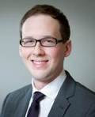
Testimonials
Matthias Kollin
Firma: PwC Österreich
Stelle: Consultant - Consulting & Risk Services
„Bei meiner Arbeit kann ich die Lehrinhalte des Instituts ideal in die Praxis umsetzen. Themen wie COBIT und ITIL sind für mich essentiell bei der Prüfung von IT-Kontrollen und Prozessen in Unternehmen. Ich bin davon überzeugt, dass die Erfahrungen dieses Kurses mir einen Vorteil beim Berufseinstieg verschafft haben.“

Slide 24

Testimonials
Milen Ivanov
Company: HILTI AG
Position: Global IT Release Manager
“Looking back, I can definitely state that the education offered at the Institute for Information Management and Control was a very good preparation for my current assignment as a Global IT Release Manager in a multinational company. In my opinion the importance of IT governance will grow more and more for all enterprises, which aim for efficiency and productivity of their IT processes, and face a demanding business environment.”

Slide 25
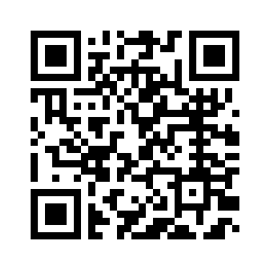
Follow-up
All information about our SBWL can be found at our institute homepage
wu.ac.at/imc

Slide 26
Questions?
Department of Information Systems and Operations
Institute for Information Management and Control
Dr. Everist Limaj,
Assistant Professor
+43-1-313 36-5224
everist.limaj@wu.ac.at

