Slide 1
Cross-Functional Management
Ao.Univ.Prof. Mag. Dr. Edith Littich
May 2021

Slide 2
The Program
CFM was relaunched in winter semester 2020/21
exclusively for students of International Business Administration
comprises courses worth 40 ECTS credits (equivalent to two specializations), entirely taught in English
international classroom experience - incoming exchange students participate in most courses
comprehensive program jointly offered by various WU departments
essentials
three core fields: Financial Management, Strategic Management & Strategic Leadership, Marketing Management
program enables students to simultaneously specialize in three functional business areas
students choose a field in which they do a project seminar

Slide 3
Why CFM may be right for you
You are looking for a comprehensive specialization ?
In CFM you gain knowledge in three business functions
You seek a highly qualified and diverse faculty?
CFM draws on excellent instructors from several WU departments and from business
You are looking for a specialization that offers interactive courses?
CFM courses typically include many interactive formats (e.g. case studies, projects) and allow for intercultural learning opportunities
You want to prepare for your exchange semester abroad in an international classroom?
CFM courses include a significant number of incoming exchange students and are entirely taught in English
You want to be flexible regarding the sequence of courses?
CFM offers a high degree of flexibility, with many courses to be recognized from your exchange semester abroad

Slide 4
Structure
Step 4: Elective of your choice
Step 2: Three core fields each à two courses (VUE and PI)
Step 1: Working in diverse teams (AG)
Step 3: Choose a project seminar in one core field (FS)
Bachelor‘s thesis

Slide 5
Course overview
Course Title | ECTS Credits | Course Type
Working in Diverse Teams | 1 | AG | Start CFM with this course
Financial Management | 5 | VUE
Special Topics in Financial Management | 5 | PI
Marketing Management | 5 | VUE
Special Topics in Marketing Management | 5 | PI
Strategic Management and Strategic Leadership | 5 | VUE
Advanced Strategic Management and Strategic Leadership | 5 | PI
Project Seminar in one of above areas | 5 | FS | Prerequisite for FS: completion of VUE + PI in the respective core field
Elective | 4 | PI

Slide 6
Examples of courses offered (study year 2022/23)
Special Topics in Financial Management
International Financial Management
Special Topics in Marketing Management
Conscious Marketing
Advanced Strategic Management and Strategic Leadership
Advanced Strategic Management
Advanced Strategic Leadership
Elective
Business Ethics and CSR
International Supply Chain Management
Human Resource Management in an International Environment
Sustainable Finance (summer semester)
Sustainable Tourism
Marketing Strategies for Emerging Markets
Credit Risk: Analysis, Measurement and Management
Managing innovation and disruptive technologies

Slide 7
Core Fields – Sequence of courses
Each core field consists of two mandatory courses (course 1 =VUE , course 2 = PI) and a Project Seminar (FS) of choice worth 5 ECTS each
It is recommended to take the VUE before the PI (or in a sequence in the same semester)
The completion of both, the VUE and the PI, are a prerequisite for the Project Seminar (FS) in that respective core field
E.g.: In order to take the Project Seminar in the core field Financial Management, you need to have completed Financial Management (VUE) and Special Topics in Financial Management (PI)

Slide 8
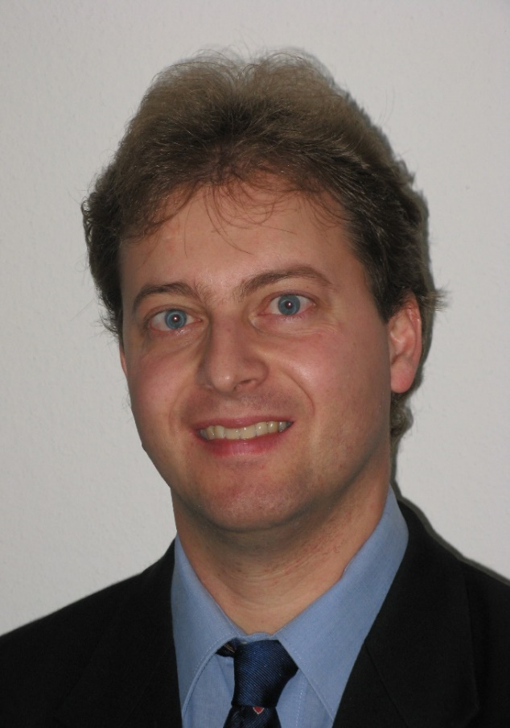
Core fields in detail – Financial Management
Finance (ao.Univ.Prof. Dr. Manfred Frühwirth & team, Department of Finance, Accounting & Statistics)
What to expect:
Overview over the different facets of Finance
Apply financial tools and techniques to real-life situations - analyze and solve personal or corporate financial problems

Slide 9
Core fields in detail – Marketing Management
Marketing (Prof. Dr. Ulrike Kaiser & team, Department of Marketing)
What to expect:
Foundations for a job or further academic studies in marketing, with a focus on digital marketing.
You will train your analytical and communication skills and gain practical experience in lectures, team projects and case studies in and outside class.

Slide 10
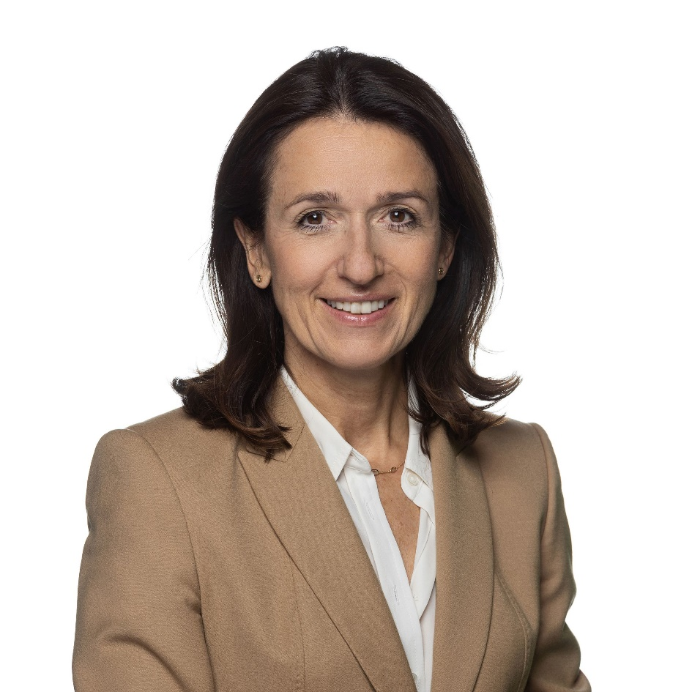
Core fields in detail – Strategic Management & Strategic Leadership
Strategic Management and Strategic Leadership (Univ. Prof. Dr. Barbara Sporn & team, Department of Strategy & Innovation)
What to expect:
Work hands-on on real case scenarios: apply concepts and theories of strategic management and strategic leadership through in-depth analysis of case studies
Hone your communication and presentation skills through interactive group assignments

Slide 11
Application requirements
The formal application requirements for Cross-Functional Management are identical to the requirements for other specializations at WU:
All STEOP exams
At least 27 ECTS credits from the Common Body of Knowledge, including Accounting & Management Control I, Accounting & Management Control II, Business Information Systems I, Statistics and Business in the Legal Context –Private Business Law I.

Slide 12
Application and selection
Application:
Upon completion of all requirements:
→ registration in LPIS for "Einstieg in das Programm Cross-functional Management"
Selection
Performance criteria:
English language skills
EBC I : grade 3 or better;
alternatively, EBC II: grade 2 or better, TOEFL (IbT) 90, IELTS 7, Cambridge Certificate in Advanced English (CAE), Business English Certificate (BEC Higher)
Previous academic performance
Grade average of results from the best 27 ECTS
Total grade average
Ranking based exclusively on those criteria – no entry exam!
Application period:
24 August 2022 (2pm) –
04 September 2022 midnight

Slide 13
Career opportunities
WU Master Programs
Foreign Master Programs
Bocconi
WU CEMS
Rotterdam School of Management
WU SIMC
WU ExInt
CBS
Groningen (RUG)
WU Management
Aston Business School
UCD Dublin
… and many more

Slide 14
Further information and contact
You can find further information on the CFM website
https://www.wu.ac.at/cross-functional-management
Prof. Dr. Edith Littich Academic coordinator
edith.littich@wu.ac.at
Anna Rösch
Administrative coordinator
cfm@wu.ac.at
+43-1-31336-4390

