Slide 1
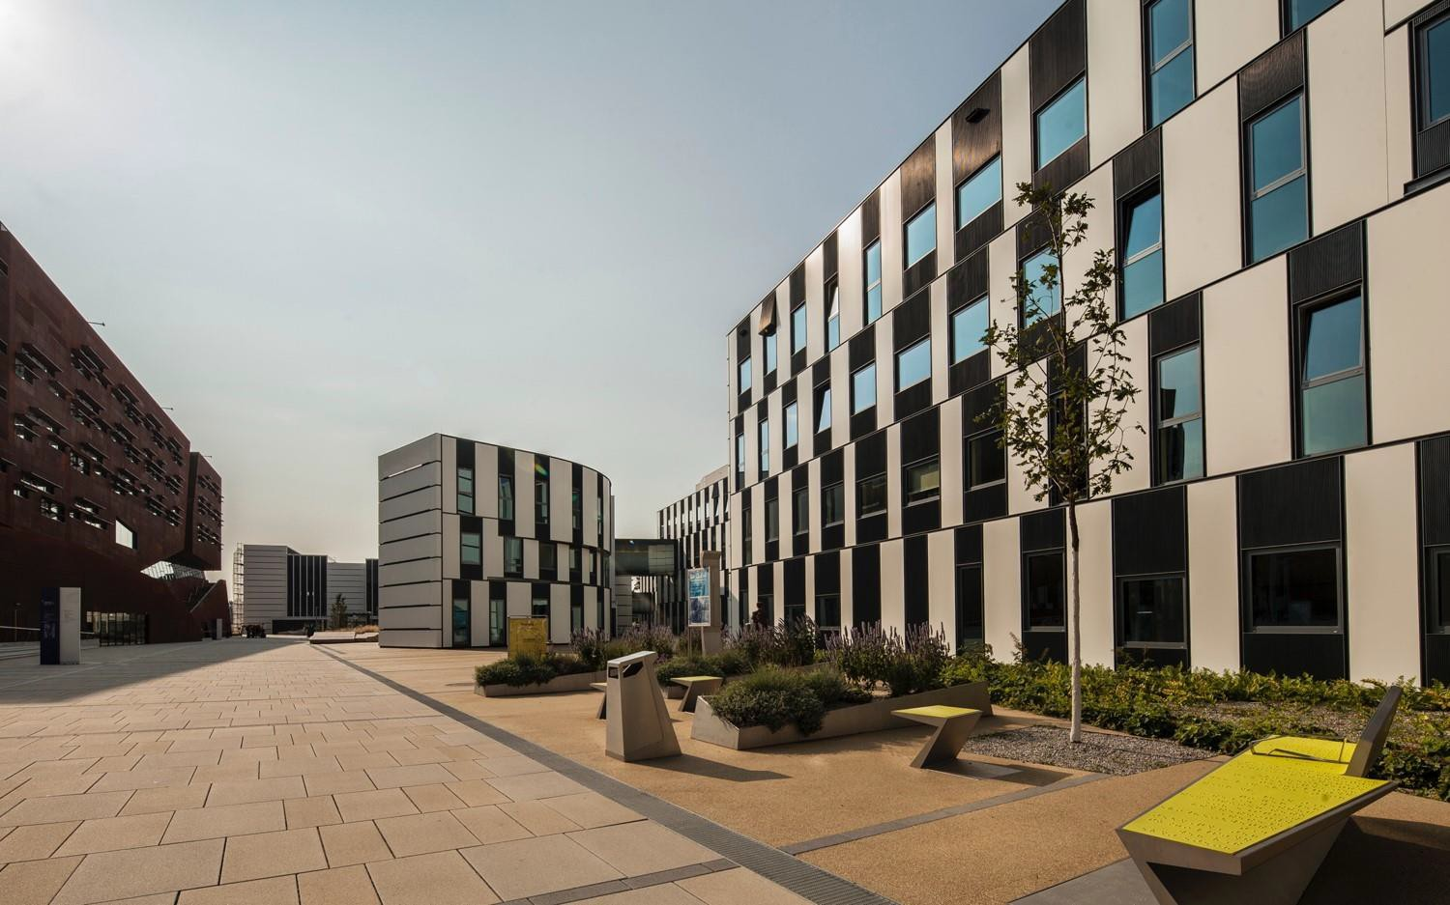
WELCOME!
SBWL Strategy and Managerial Accounting
15.01.2024
Institute for Strategy and Managerial Accounting
Univ.-Prof. Dr. Gerhard Speckbacher
Univ.-Prof. Dr. Isabella Grabner
Assoc. Prof. Dr. Christoph Feichter
Ass.Prof. Dr. Otto Janschek

Slide 2
What to expect
Strategy & Managerial Accounting…
Firm DNA
Doing the right things
… focuses on how companies formulate, implement and (re)evaluate their strategy to achieve the company's short and long-term goals.
Target Setting
Strategy Formulation
Strategy
Our graduates…
Strategy Evaluation
… understand how financial & strategic metrics and modern analytical methods can be used to prepare and make business decisions.
Strategy Implementation
Doing the things right
Reality Check

Slide 3
Our program focuses on three complementary pillars
Expertise
Up-to-date and well-founded expert knowledge
Application of knowledge to practical issues
Academic Attitude
Evidence-based decision-making
Critically challenging assumptions
Sound judgments based on limited information
Managerial Skills
Project management, leadership, teamwork and networking skills
Personality development in order to promote socially responsible action

Slide 4
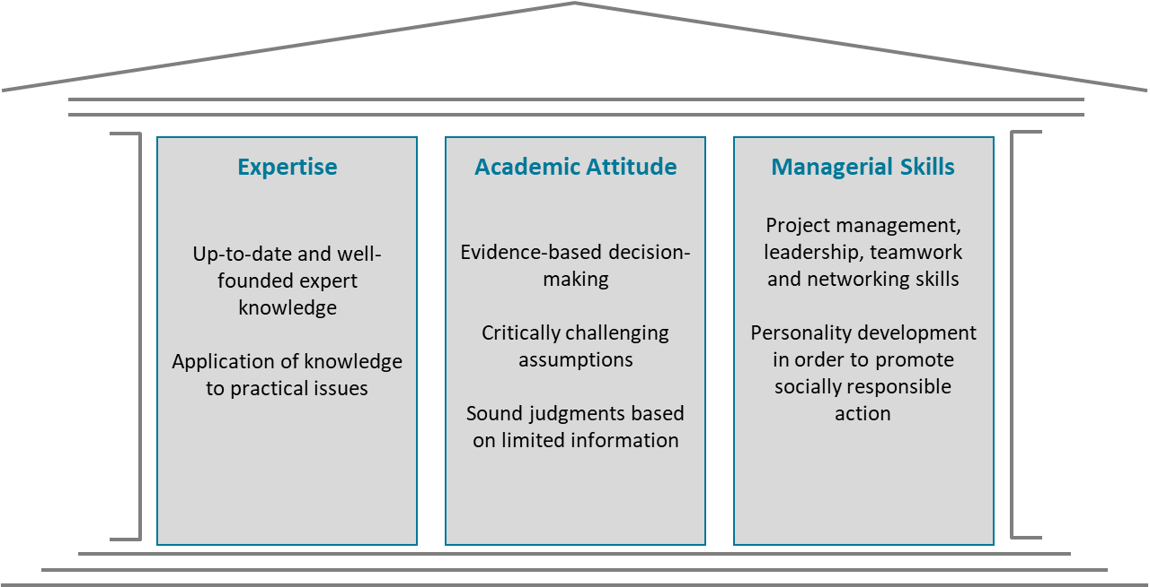
Which career prospects will you have?
Opportunity for deepening
one's knowledge
3 typical career paths
Future Management Positions in Controlling and Finance
+
Focus on Value-Based Management
Choice of Course 5
+
Consulting-specific Know-how
Choice of Consulting LIVE
Future Top-Management Consultants
Preparation for Top-Management Position
(Family Business / Start-Up)
+
Hands-on Skills
Choice of Business Project

Slide 5
Is Strategy and Managerial Accounting right for YOU??
Are you interested in understanding the (financial) consequences of managerial decisions?
Do you like to work on challenging tasks in teams of highly motivated students?
Are you ambitious and performance-focused, and do you like to share your enthusiasm with your fellow students?
Are you open-minded and do you like to work in teams in a collaborative environment?

Slide 6
SBWL Overview
1st Semester
2nd Semester
Course I
Introduction to Strategy and Managerial Accounting
Course III
Business Analysis Project
Course III
Theory Business Project
Course II
Strategic Business Analytics and Investment Decisions
Course IV
Business
Forecasting Project
Course IV
Business Project
2nd or 3rd Semester
All 5 courses are graded based on continuous assessment (PI)
Course V Final Seminar
Course V Final Seminar
Course V Final Seminar
Optional: Bachelor Thesis at IfU or ICG

Slide 7
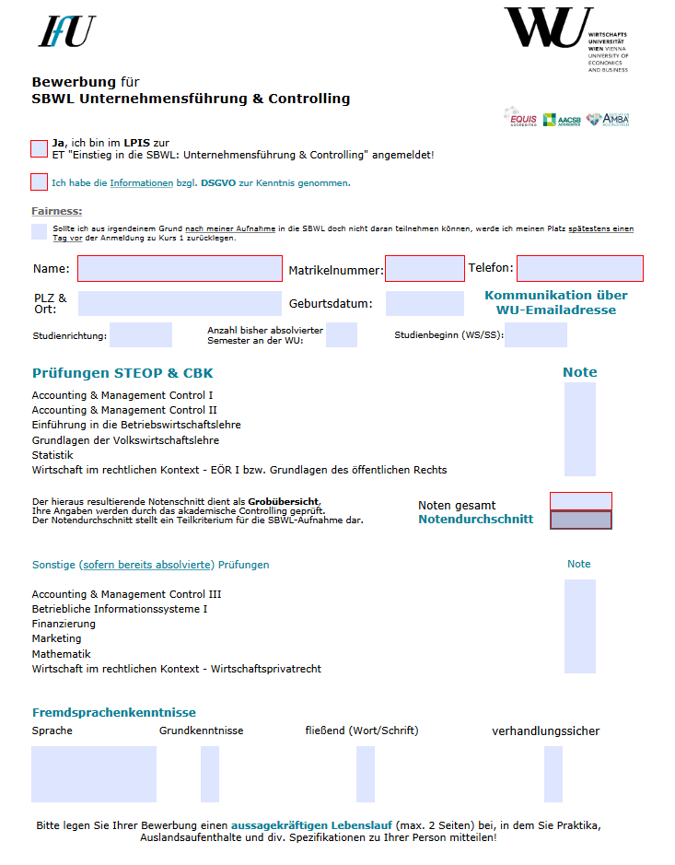
Two ways into our SBWL
Selection on GPA
You can find the standardized application form and selection criteria on www.wu.ac.at/ifu
Best 5% of the official WU student ranking of the same cohort
Best 5% of the official WU student ranking of the same cohort
OR
Formal Entry Requirements
Grade point average (GPA) of all exams in the Common Body of Knowledge (CBK)
Motivation Letter
Justify your intention to participate and describe the contribution that YOU can make!
Other Selection Criteria/ CV
Work experience, internships, foreign language skills, international experience

Slide 8
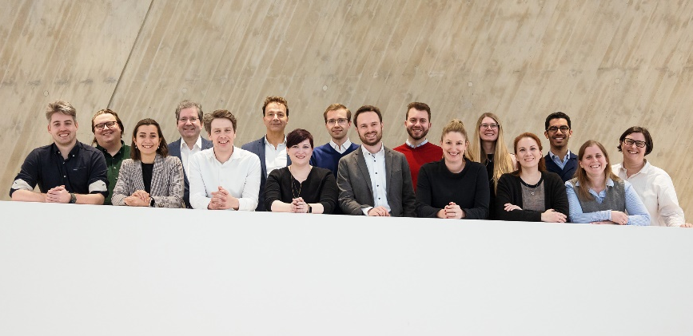
The IfU Team
Professors
Assistants
Univ.-Prof. Dr. Gerhard Speckbacher
Univ.-Prof. Dr. Isabella Grabner
Assoc. Prof. Dr. Christoph Feichter
Ass.Prof. Dr. Otto Janschek
Konstantin Grün, MA HSG
Florian Loizl, MSc
Saam Mahmoodian, MSc
Katharine Patterson, CPA, CA
Anja Pichler, MSc
Gianluca Piucco, MSc
Tanja Schiffner, MSc
Dr. Markus Wabnegg, MIM
Martin Wiernsperger MSc, MBA
Lea Zwickl, MSc MA
Secretary‘s Office
Karin Zemanek

Slide 9
Get in touch and stay in touch!
IfU Lounge D5, 6th floor
Next Event: 6th March, after Welcome@IfU
Find news on our homepage:
https://www.wu.ac.at/ifu/network/ifu-lounge

Slide 10
Contact IfU
Location | Building D5, 5th/6th floor
Opening Hours | Tuesday-Thursday: 10:00 a.m. - 12:00 p.m., Tuesday additionally: 2:00 p.m. – 4:00 p.m.
Office Hours | Univ.-Prof. Dr. Gerhard Speckbacher, Univ.-Prof. Dr. Isabella Grabner, Assoc. Prof. Dr. Christoph Feichter, Ass.Prof. Dr. Otto Janschek: By arrangement and at IfU Lounge Event Assistants: By arrangement and at IfU Lounge Event
Website/Media | www.wu.ac.at/ifu @ifuwuvienna

Slide 11
Business Project: Students as a consulting team!
Application of Business Know-How
Development of Soft Skills
Business projects address current challenges in practices (e.g., stakeholder management, performance management, risk management, corporate governance)
This allows for a transfer of know-how between science and practice
Hands-on coordination and planning of a business project as an important skill for students
Presentation skills – Interim and final presentations in front of high-ranking company representatives
Business projects challenge students in terms of team dynamics, leadership and communication processes
Examples of Past Business Projects
„Business Analysis Project“ + „Business Forecasting Project“
A selection of partners from past business projects:
Austria Wien, Austrian Airlines, Austrian Research Center, AXA Nordstern Colonia, Böhler Schmiedetechnik, Böhler Uddeholm, IKEA, Education First Austria, Erste Bank, Boston Consulting Group, Hauswirth, Kapsch, KPMG, Lenzing, Mobilkom, NXP Sound Solutions, OMV, ÖBB, Österreichische Post, Österreichisches Controller-Institut, Palfinger, Philips, Roland Berger, Rosenbauer, Siemens, Telekom Austria, Unilever, Verbund AG, Volksbank AG, WKÖ
„Sustainability at REWE International: Workflow Optimization and Sustainability Project Evaluation“

Slide 12
Consulting-Partnerships Know-how for Joining Top Management Consultancies
Experience Consulting Live (always in the summer term)
Close cooperation with consulting firms in core courses
Insights into different approaches of management consulting firms
Close contact between consultancies and students
Presentation of case studies in front of company representatives
Transfer of Know-how
Our Current Partners
Past partners: Accenture, Cap Gemini, Czipin, Deloitte, KPMG, Mercer Management Consulting, Monitor Group, Oliver Wyman, Stern Stewart & Co.

Slide 13
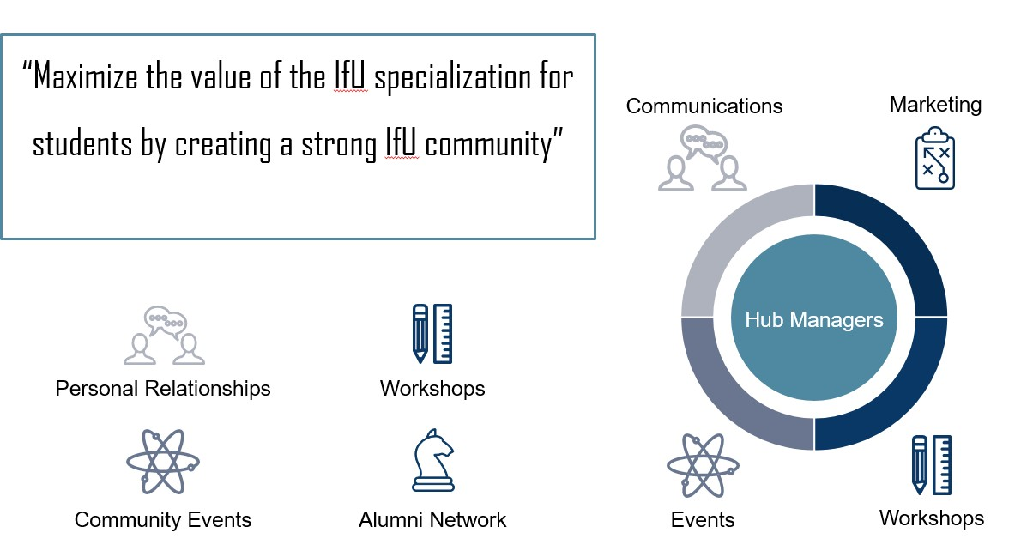
IfU Community Hub

