Slide 1
SBWL-Messe der ÖH WU
Januar 2024
Notes:
Chancen reinzukommen? > 45 (von …) ca. 100-120 anmeldungen, antritt ca 80. Ca. 40-50% Annahmewahrscheinlichkeit.)
Wie aufwändig?
1. Allgemeines Marketingwissen wird vorausgesetzt Kotler/Chernev, nachgewiesen über Kurs “Marketing” im allgemeinen Teil BBE (Margit Kastner).
2. HBR Artikel, Fragen zu IMM.
3. 45min Zeit, 20-40 Fragen, MCQ
Wie viele Punkte muss man erreichen: > die Top 45 werden zugelassen.

Slide 2
Our Team
Univ.Prof. Dr.
Marius Lüdicke
ao.Univ.Prof. Mag.Dr.Phil. Elfriede Penz
Prof. Dr. Mag.Dr.rer.soc.oec. Barbara Stöttinger
Head of the IMM
Deputy Head of the IMM
Dean of the Executive Academy
Mag. Thomas Freudenreich
Mag. Milos Ivanis
Pamela Taylor
Research and Teaching Associate
Institute Assistant
Research and Teaching Associate

Slide 3
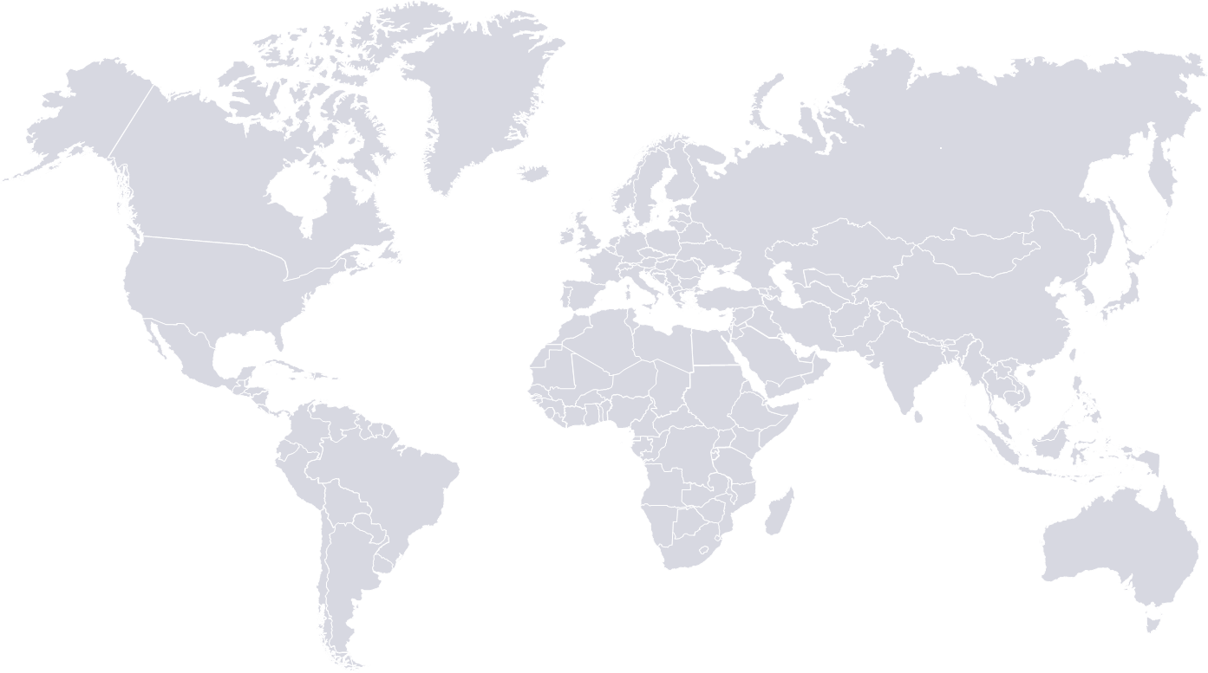
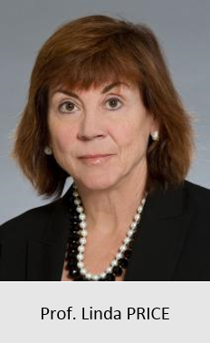
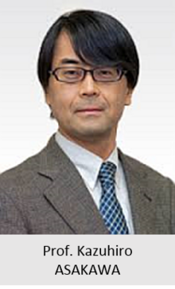
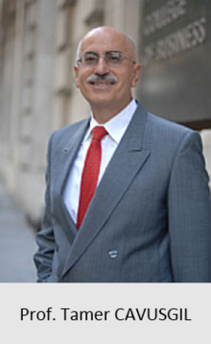
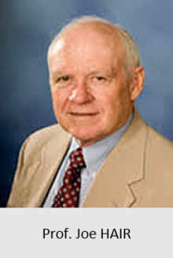
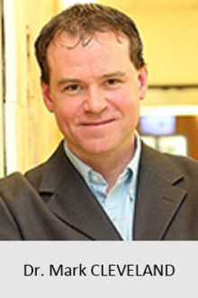
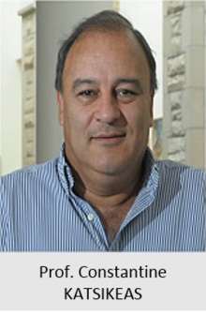
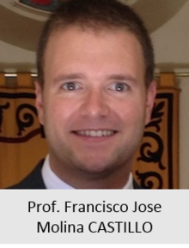
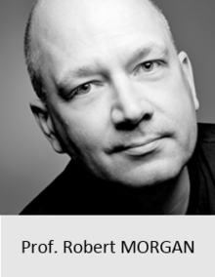
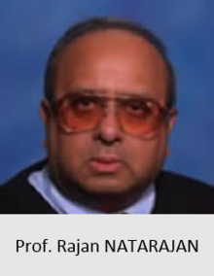
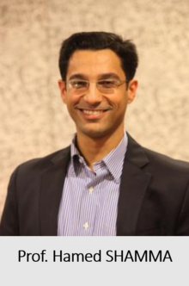
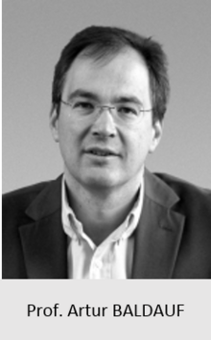
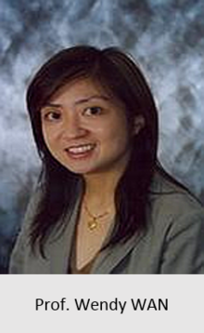
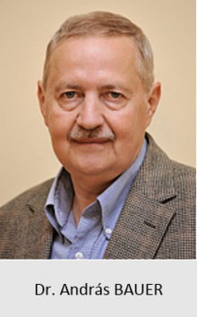
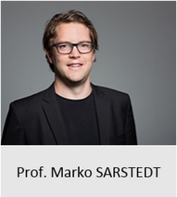
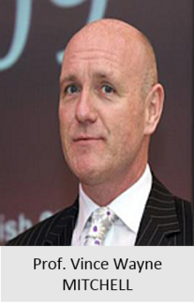
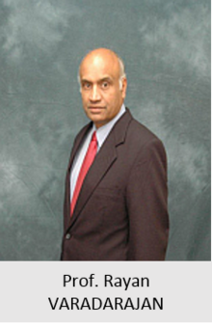
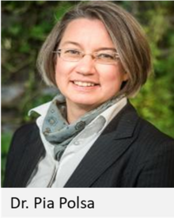
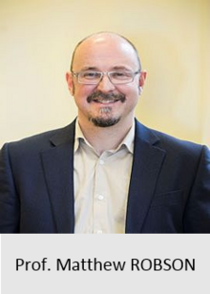
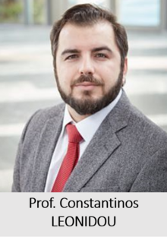
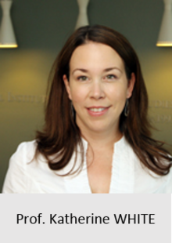
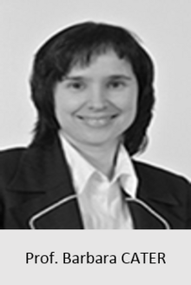
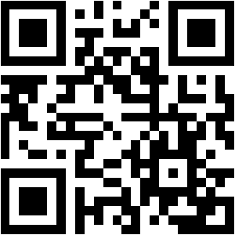
Our Guest Professors
And More...

Slide 4
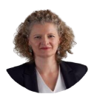
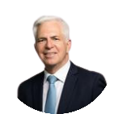
Our Research
Global consumer society
Equality, diversity, inclusion
Sustainability
Consumer behaviour
Global brands
Global strategy and innovation

Slide 5
Our Research
100+
Publications in
Top Journals
100+
10+
Presentations at
International
Conferences
National and
European
Research Projects
20+
20+
Research and
Teaching Awards
Journal Review
Board Memberships
Notes:
Beispiel:
“Innovative Lehre Award für Global Business Planning”,
Nominiert für den Staatspreis für Lehre!

Slide 6
Our Teaching
B.Sc. in Business and
Economics
Ph.D. in Marketing
Advanced Qualitative
Methods
Paper Development
Workshop
Methods II
Global Branding
Global Media Marketing
Global Marketing Research
Marketing in the Emerging
Markets
Future Trends in International
Business
Global Marketing Communication
International Marketing in Asia
Global B-2-B Marketing
M.Sc. in Marketing
MSc Strategic Marketing in a
Globalized Economy
CEMS Global Marketing Management
Special Topics in IM
Qualitative Insights
Marketing Study Project
Notes:
IMM teaches ca. 240 students every year and has graduated more than 3.000 students.

Slide 7
Why Specialize in International Marketing Management?
Notes:
Global marketing is marketing plus an international dimension.
> Broaden your horizon (or keep it broad)

Slide 8
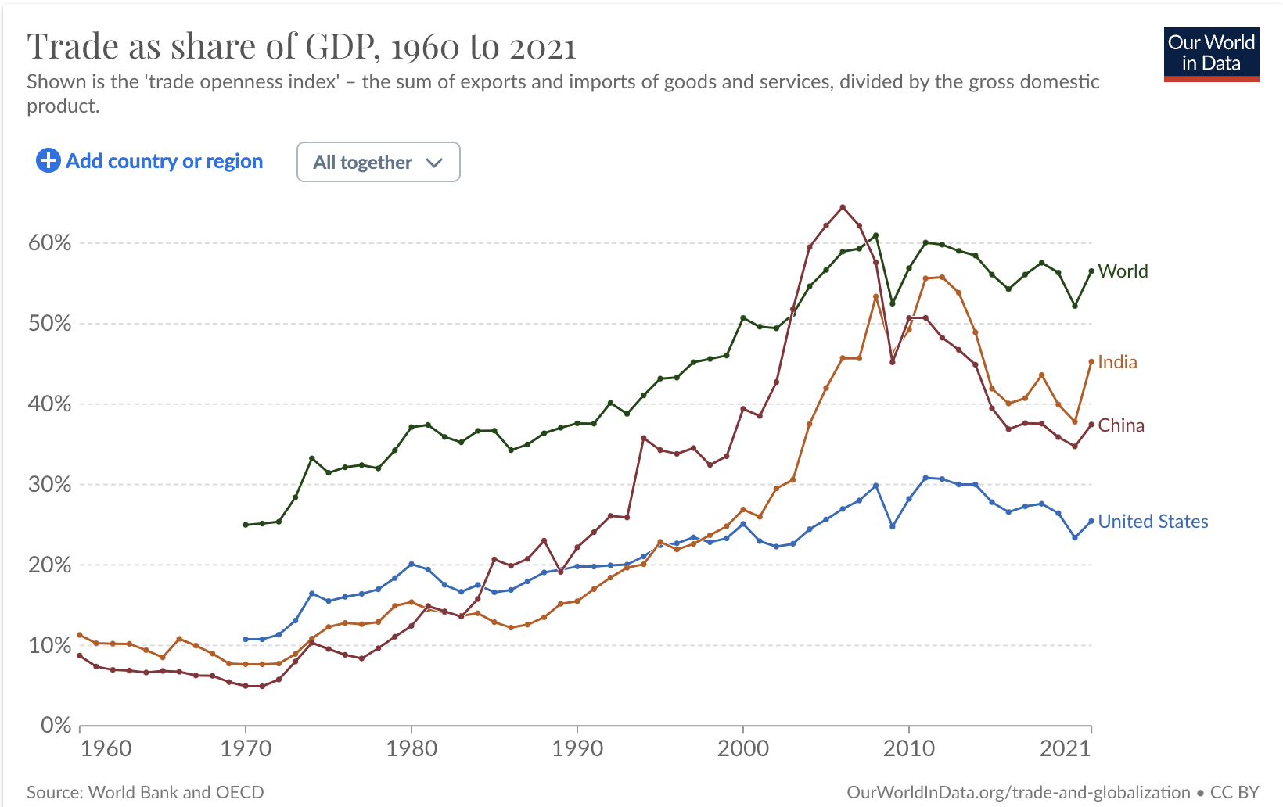
Why Specialize in International Marketing Management?
The world has become a gigantic global market. The most exciting companies you can work for today are operating in multiple countries.
Notes:
The world is globally connected. Even local companies are embedded in global supply chains…
trade-to-GDP ratio: quite a bit more than 20%, is it?
Here imports and exports are added up > what we see is a trend here.
China imports silizium, for example, builds a chip from it and exports it: both transactions are added up here and related to domestic output. There is only one final product that is exported B2C, but lots of B2B trade occurs to build it. We cannot ignore that figure!
An IMF publication states that, "GDP measures the monetary value of final goods and services—that are bought by the final user—produced in a country in a given period (say a quarter or a year)."^{[9]}
GDP (nominal) per capita does not, however, reflect differences in the cost of living and the inflation rates of the countries; therefore, using a basis of GDP per capita at purchasing power parity (PPP) may be more useful when comparing living standards between nations, while nominal GDP is more useful comparing national economies on the international market.^{[10]} Total GDP can also be broken down into the contribution of each industry or sector of the economy.^{[11]} The ratio of GDP to the total population of the region is the per capita GDP (also called the Mean Standard of Living).

Slide 9
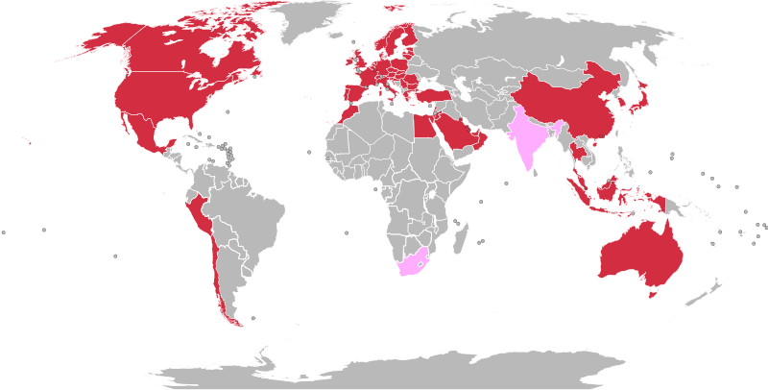
Why Specialize in International Marketing Management?
If you want to serve, or even save, the world, you need a profound understanding of how companies compete and collaborate internationally.
https://en.wikipedia.org/wiki/File:H%26M_World_map.svg#metadata
https://www.statista.com/statistics/268522/number-of-stores-worldwide-of-the-hundm-group-by-country/
Notes:
More impact
The total number of H&M stores worldwide amounted to 4,465 in that year. McDonalds has 40.000 Restaurants.
https://www.statista.com/statistics/268522/number-of-stores-worldwide-of-the-hundm-group-by-country/

Slide 10
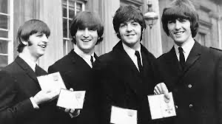
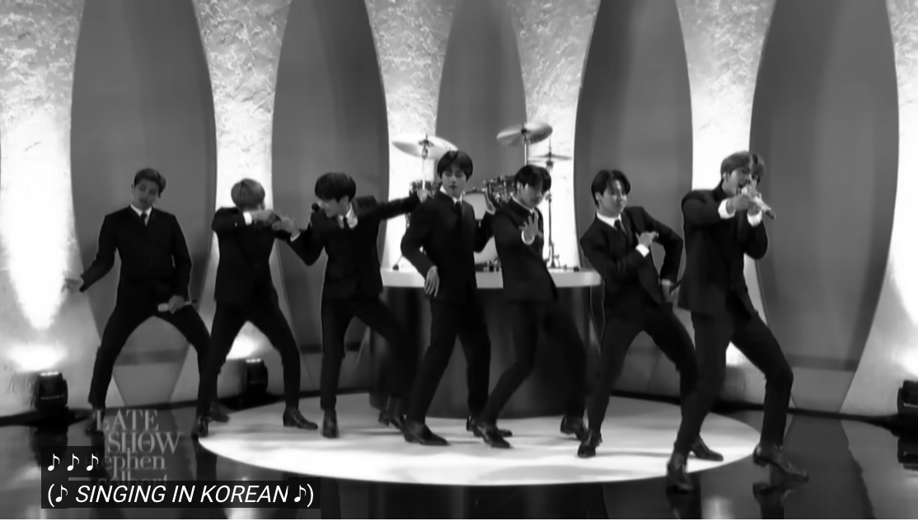
Why Specialize in International Marketing Management?
Today, people, money, products, fashions, tastes, and ideas travel across the globe in all directions. As a global marketer, you follow international trends to build the strongest brands.
“People from Hong Kong, Japan and the Philippines loved the mop-topped Englishmen from Liverpool in the 1960s. In Japan, a Beatles fan described their show as a “social phenomenon” which led to the birth of a real Japanese rock music scene.”
“50 years after „Beatlesmania“ swept the globe, BTS successfully invaded the US, fans from all around the world also cry, scream and sing along at concerts. In 2019, BTS became the first band since The Beatles to have three Billboard No.1 albums in a single year.”
https://youtu.be/Wp2DqGnlShM, https://www.beatlesstory.com/blog/2021/02/10/the-beatles-in-asia/
https://youtu.be/Wp2DqGnlShM. https://www.beatlesstory.com/blog/2021/02/10/the-beatles-in-asia/
Notes:
More interesting! Global perspective. Grow with it.
Learn how to study international markets

Slide 11
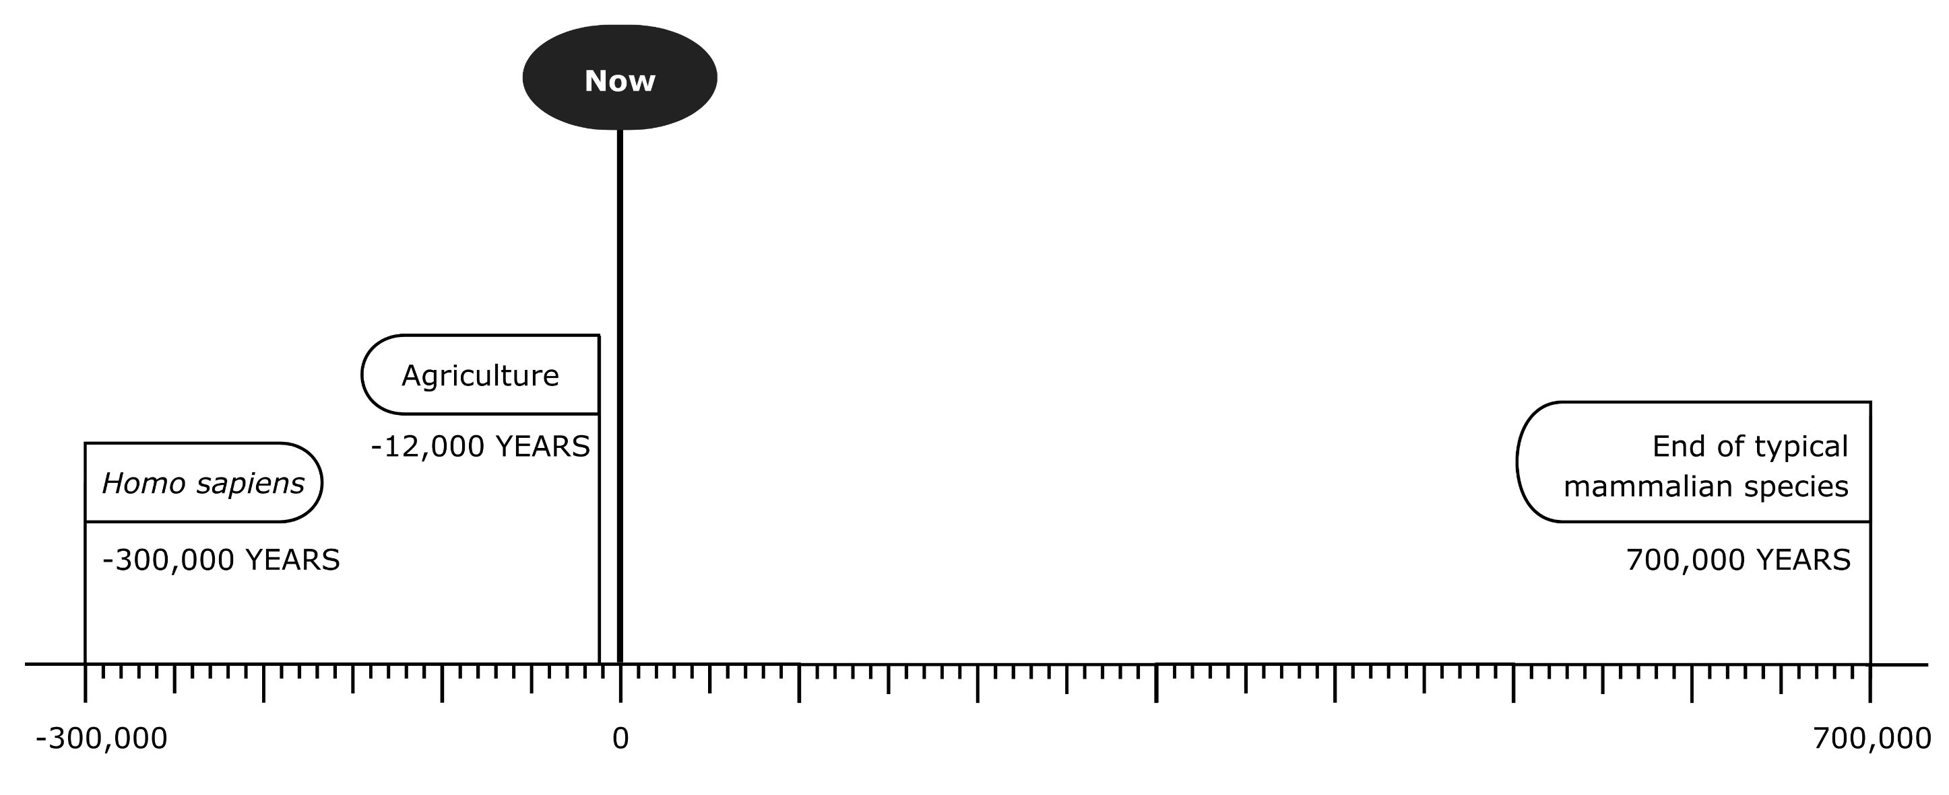
Why Specialize in International Marketing Management?
As a global marketer, you have global impact. You can contribute proactively to shaping our future which “could last for millions of years or end tomorrow … depending on what we choose to do today.“*
Figure 1.2. The potential future of civilisation, if humans survive as long as the average mammalian species

Slide 12
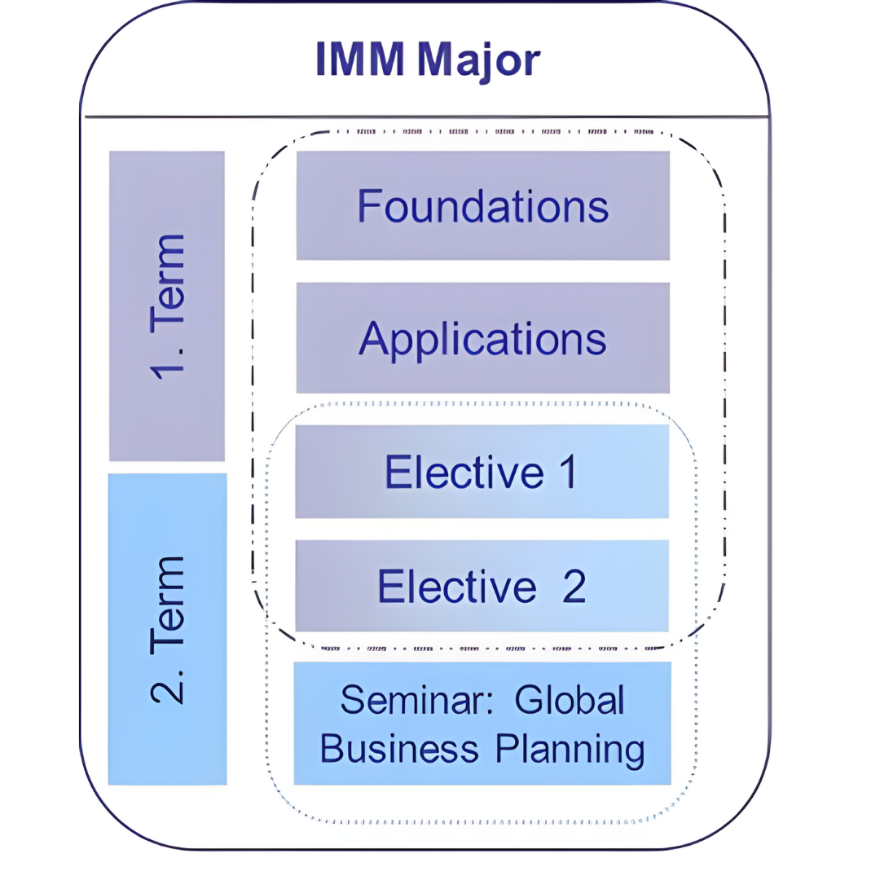
SBWL International Marketing Management: Overview
Contents
5 courses (10 SWS/20 ECTS)
2 semesters minimum
International electives with IMM contents are acceptable (upon approval)
GBP can be studied online from abroad
Language
English
Bachelor Thesis
Common Body of Knowledge, “Wissenschaftliches Arbeiten” courses completed
English language
IMM students preferred
Notes:
CBK: common body of knowledge > Voraussetzung
GWA: Grundlagen wissenschatflichen Arbeitens
Siehe: https://www.wu.ac.at/studierende/mein-studium/bachelor/ueberblick-1/wiso23/
Halbes Jahr Orientierungsphase + 1.5 Jahre Common Body of Knowledge (Grundstudium)
Danach 2 Jahre Hauptstudium in BWL, Internationale BWL (oder WI VWL; wirtschaft umwelt politik) mit Spezialisierung in IMM, etc. > 36 ECTS, ca 8 Veranstaltungen.
+ Spezialisierug > IMM dauert mind. 1 Jahr! > 5 courses, 20 ECTS.
Können sie das in einem Semester machen? Können sie nicht.
F&A im ersten Semester, plus elective. Seminar im 2. Term plus 2. Elective.
3 Semester geht, 1 geht nicht

Slide 13
SBWL International Marketing Management: Didactical Concept
Foundations
(1. Sem.)
Applications
(1. Sem.)
Global Business
Planning
(2. Sem., online)
Key concepts:: Int. market entry, STP, marketing mix, contemp. topics, etc.
Implementation via simulation: Make STP, product portfolio, budget, KPIs, strategy decisions
Implementation via consulting: Work in multi-cultural teams to advise a company
Content
Along the international marketing plan
Marketing plan elements integrating quantitative marketing aspects
Along the lines of an international marketing plan integrating market research
Organization
Cases
Concrete & hands-on decision-making in simulation
Marketing strategy development & execution for a real-life company situation
Practice
orientation
Examples
etc.
Discussions
Selected concepts &
practical application
Holistic & comprehensive
practical application
Notes:
Sem F (Barbara, fallbeispiele und diskussionen) & A (Simbrunner, Ivanis, Thomas), > simulation, decision making, quantitative Aspekte berücksichtigen)
Foundations https://vvz.wu.ac.at/cgi-bin/vvz.pl?C=S&LANG=DE&U=H&S=23S&LV=3&L2=S&L3=S&T=&L=&I=4287&JOIN=AND
The reality of a global market place
Markets in different stages of development: from economically developed to emerging and bottom-of-the-pyramid markets
Assessing the international environment across markets (e.g., PEST)
Market assessment and selection
Market entry alternatives
Global Market Segmentation - Targeting - Positioning
The Global Marketing Mix
Balancing standardization vs. adaptation of the global marketing mix
contemporary topics in global marketing
2. Sem GBP (Penz, where everythings comes together: integrates concepts, theories in real-live contexts: > Firma selbst aussuchen! Saturo, HelloBello, Schalk Mühle, Koni, Ketofabrik … (KMU in Österreich) > help them internationalize, have impact.
https://vvz.wu.ac.at/cgi-bin/vvz.pl?C=S&LANG=DE&U=H&S=23S&LV=3&L2=S&L3=S&T=&L=&I=4054&JOIN=AND
Segmentation-Targeting-Positioning
The 4 P's in practice
Product portfolio management
Marketing budget allocation
Key Performance Indicators (KPI's)
Strategy development and execution

Slide 14
SBWL International Marketing Management: Electives
Future Trends in International Business
Global Branding
Global Media Marketing
Global Marketing Communication
Global Marketing Research
Global B-2-B Marketing
International Marketing in Asia
Marketing in Emerging Markets
Notes:
Abhängig von den Gästen die wir einladen. Nicht alles findet immer statt (SS+WS)
External teachers, some PhDs from our institute that have worked in practice for a while.
My module: global branding:
- An understanding of the value of global brands
- Knowledge and skills to meet the challenges of successful brand management
- Insights on how to position the brand in consumers minds
- Ability to assess and successfully implement brand elements and marketing activities to build brand equity
- Skills to manage customer experience and touchpoints
- Discuss new trends in branding

Slide 15
SBWL International Marketing Management: Teaching Methods
Case Studies
Teamwork & Coaching
Presentations & Reports
Online elements
Concepts & Theories
Project work
Cooperation with renowned companies & start-ups
Active participation in discussions
Notes:
GBP: Coaching einheiten mit Elfriede etc.
Thomas: case studies presentieren, GBP: eintrittsstrategy präsentieren.
> Exams and tests: Electives have tests. Foundations: Prüfungen?

Slide 16
SBWL International Marketing Management: Bachelor Thesis
Topics are generally assigned in line with the research focus of the institute
Examples of topics:
Sustainability and Corporate Social Responsibility
The role of brands in consumer decisions
"Euro consumer" - does it exist and what characterizes it?
Brand counterfeiting / digital piracy: attitudes, emotions, etc.
International Pricing in SME
Find out more at our Bachelor Thesis Info Event!
Notes:
More information:
https://www.wu.ac.at/en/imm/student-platform/bachelor/paper/
No deadlines.
Supervisors:
Profs Penz, Barbara,
PhDs Thomas and Milos co-supervise,
Haas-Kotzegger, Sharma, Gina Vilanueva-Weinzierl…

Slide 17
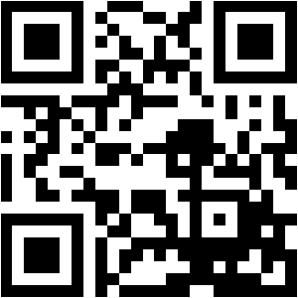
SBWL International Marketing Management: Entry Exam
DATE AND TIME
7th February 2024, 9:00 am - 9:45 am (online)
REGISTRATIONS
1st February - 4th February 2024, via LPIS
PREREQUISITES
For BaWiSo and BaWiRe students:
- min 27 ECTS and
- completed basic Marketing Course (Dr. Margit Kastner)
For BBE students:
- min 42 ECTS
CONTENT
http://short.wu.ac.at/imm-entry
FORMAT
Single-choice questions (40%) and multiple-choice questions (60%). Online via LEARN
LANGUAGE
English
Notes:
Grade = Pass
BBE studierende brauchen den Nachweis nicht hochzuladen > Nachreichen falls die Prüfung noch nicht gemacht ist. > längeres programm? Brauchen nur eine Spezialisierung?
BA Wirtschafts- und Sozialwissenschaften: ist das Standardprogramm, deutsch,

Slide 18
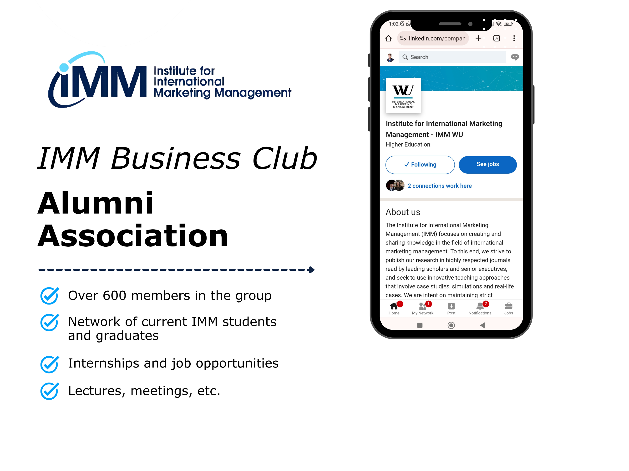
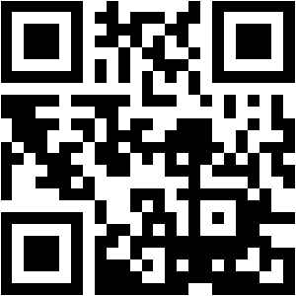
The IMM Network: Join a Global Community of IMM Graduates
https://www.wu.ac.at/en/imm/

Slide 19
INTERNATIONAL MARKETING MANAGEMENT
Welthandelsplatz 1, 1020 Vienna, Austria
UNIV.PROF. DR. MARIUS LÜDICKE
T +43-1-313 36-5991
F +43-1-313 36-DW
imm@wu.ac.at
www.wu.ac.at

Slide 20
SBWL International Marketing Management: What you will learn
Devise
Prepare
appropriate strategic concepts
Compile
for taking complex decision choices in global
marketing
detailed implementation guidelines
Identify and analyze
Utilize
Both qualitative & quantitative methods
Opportunities & Risks
Not sure this slide is needed, or is it? I wouldn't learn much from it as a student, don't think it's necessary
Notes:
Warum IMM:
Complex decisions in global marketing, methods to identify market opportunities and risks (in Global Business Planning), Konzepte anwenden, Marktforschung qual and quant.
Compile: > Wissen anwenden in praktischen Fragestellungen. E.g. Global Business Planning: mit Firmen Markteintrittsstrategien ausarbeiten die dann evtl. angewendet werden.

Slide 21
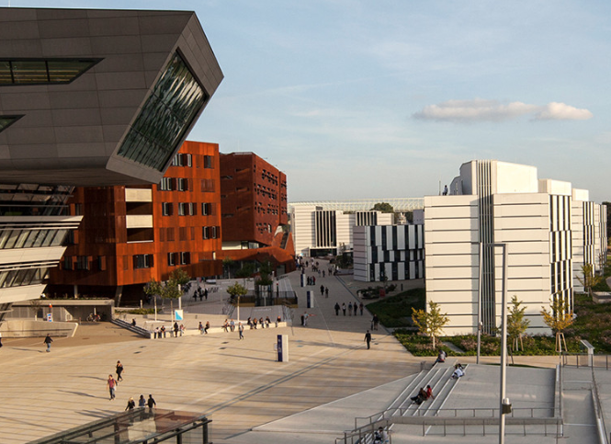
Where to find us: D2a, 2nd Floor

