Slide 1

Entrepreneurship & Innovation (E&I)
Univ. Prof. Dr. Nikolaus Franke

Slide 2

Entrepreneurship & Innovation

Slide 3
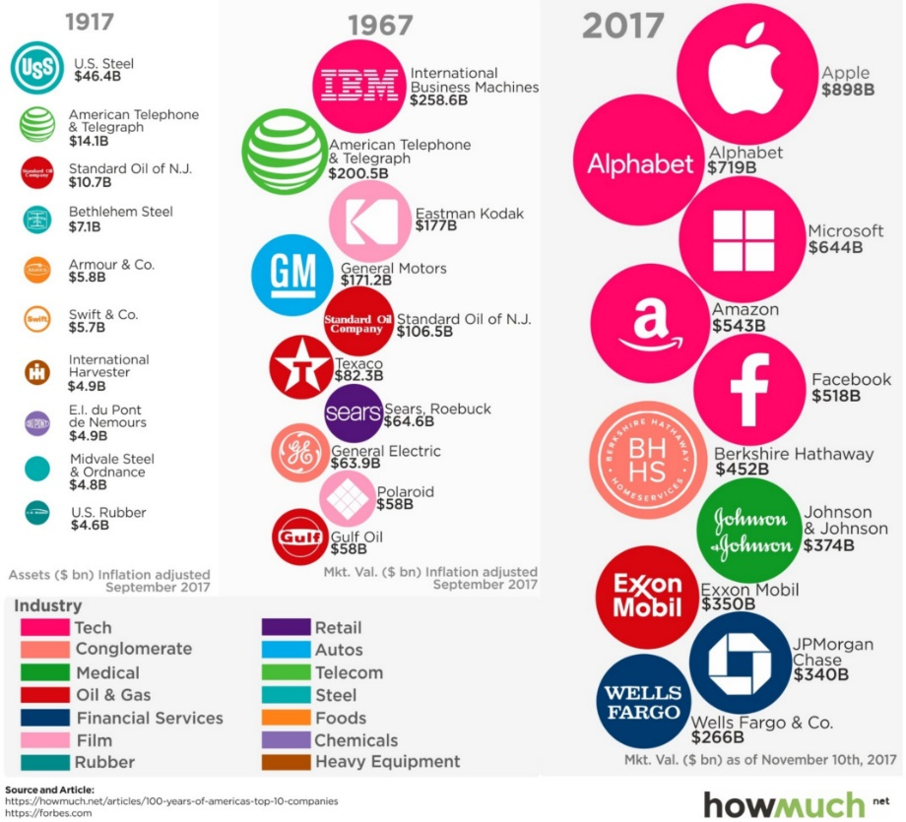


The world is changing dramatically…
„How Kodak failed… missing opportunities in digital photography, a technology that it invented.“
„We didn‘t do anything wrong, but somehow, we lost.“
Notes:
100 Years of America´s Top 10 Companies: historical examples of companies that have come and gone.
The size of the circle corresponds to the company’s valuation adjusted for inflation to 2017 dollars.
The United States is far wealthier now than it was 50 or 100 years ago. The largest companies are significantly larger and worth more than the largest companies in 1967 and 1917.
The top ten largest companies in each year are all different. The rankings change, and as time goes on, companies lose their place on top of the list. The one exception is AT&T, which held the second spot in 1917 and 1967. That is, until the U.S. government famously broke up AT&T (which is why it’s probably not in the top 10 today). AT&T is the exception that proves the rule.
Most of these companies still exist today, but only because they went through substantial business model changes or were acquired by a competitor. Steel companies aren’t nearly as important as they once were. Within the energy sector, Texaco and Standard Oil both merged with competitors. Polaroid and Kodak essentially became obsolete.
Example: Kodak:
Steve Sasson, the Kodak engineer who invented the first digital camera in 1975, characterized the initial corporate response to his invention this way: But it was filmless photography, so management’s reaction was, ‘that’s cute—but don’t tell anyone about it.’
Kodak management’s inability to see digital photography as a disruptive technology, even as its researchers extended the boundaries of the technology, would continue for decades.
Kodak´s management lacked: Having an enterprise mindset that is open to change. Being able to adapt the business design to changing conditions.
Another example: Nokia:
For years top phone producer, by the end of 2007, half of all smartphones sold in the world were still Nokias. 2007 Steve Jobs introduced the iPhone.
“There’s no chance that the iPhone is going to get any significant market share” Steve Ballmer, Microsoft CEO
But: Nokia went down from 50% market share (2007) to 1% in 2019. Apple: 5% in 2017 to 42% (2019)
Nokia: phone first and a computer second. Apple: primarily a computer! (and nicely designed)
The world is not static! Managers lacked the understanding of the dynamics of business and industry.
The economy has undergone significant changes over the last century, and the creative destruction will churn on.
You can be sure that the top ten companies in 2067 will look substantially different than today, and just imagine what the list will look like in 2117.

Slide 4



…for each and every organization
+
+
Start-ups and smaller businesses
Larger and more established
businesses
NGOs,
research, politics…
Notes:
The ability to innovate is key.

Slide 5


…and E&I helps you make sense of it all
Business
Technology
Entrepreneur
Innovation = Idea and (!) implementation
Notes:
Entrepreneurs are the people-side of innovation. Without entrepreneurs, innovations are not possible.
Maybe you know the famous quote: Nothing is as powerful as an idea whose time has come (Viktor Hugo). But ideas are not powerful at all, alone are weak. They need people who believe in them, who defend them and help them developing into something powerful.
Entrepreneurs bring innovation to life and transform ideas into marketable products/services.

Slide 6
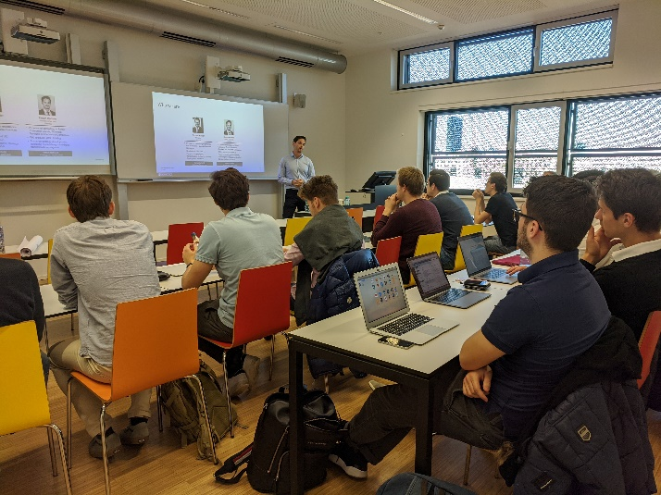

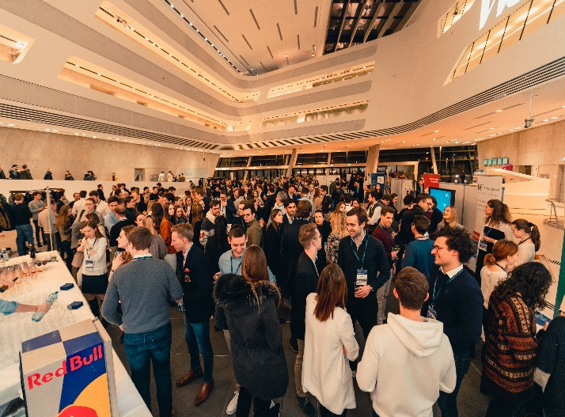
E&I is a winning combination
E&I is interdisciplinary. It combines aspects of strategy, marketing, organization, financing, project management & other disciplines from business administration.
+
+
Knowledge
Application
Network

Slide 7



E&I is a good fit for you, if you
… have an entrepreneurial mindset
… are high potential
… willing to invest in your skills
Notes:
We want to encourage you to learn during the semester, not just before the exam and to make use of your training opportunities.
You will be happy at E&I if you are looking for a specialization that will take you to the limits of your capabilities.
You can benefit of this challenge in developing yourself personally, even if it means a high amount of effort that goes beyond the scope of other specializations.

Slide 8
E&I specialization course overview
The specialization can be completed within 2 semesters. We recommend to take 2-3 semesters.
Knowledge
Course 1: E&I Core Lecture 1
Knowledge
Course 2: E&I Core Lecture 2
Application & Networking
Entrepreneurial Practice
Private Equity und Venture Capital
Product and Service Design
Fintech Lab: Design your own Start-up
Course 3: E&I Zone
Mix
InnoLab
Consulting
Business Planning
Digital Strategy Lab
Course 4 and 5: E&I Project I and II
Venture Building
Scenario Planning: Anticipate Disruption
Garage: Build your own Start-up
Industry and Innovation
Application

Slide 9
E&I specialization courses in detail
As foundation, core lectures provide an overview of entrepreneurship & innovation management fields, central theories & methods and current research topics.
Knowledge
Course 1: E&I Core Lecture 1
Knowledge
Course 2: E&I Core Lecture 2
Application & Networking
Entrepreneurial Practice
Private Equity und Venture Capital
Product and Service Design
Fintech Lab: Design your own Start-up
Course 3: E&I Zone
Mix
InnoLab
Consulting
Business Planning
Digital Strategy Lab
Course 4 and 5: E&I Project I and II
Venture Building
Scenario Planning: Anticipate Disruption
Garage: Build your own Start-up
Industry and Innovation
Application

Slide 10


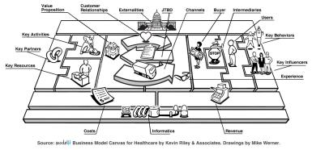
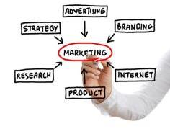

Theory, tools, methods
How to find
breakthrough ideas
How to design winning innovation strategies
How to organize the innovation process
How to market innovation
How to finance innovation

Slide 11






New ways of creating value
New products
New services
New technologies
New combinations
New processes
New business models

Slide 12
E&I specialization courses in detail
Zone courses offer you a mix of knowledge and application and can be chosen as per your personal preferences.*
Knowledge
Knowledge
Course 1: E&I Core Lecture 1
Course 1: E&I Core Lecture 1
Knowledge
Knowledge
Course 2: E&I Core Lecture 2
Course 2: E&I Core Lecture 2
Application & Networking
Entrepreneurial Practice
Private Equity und Venture Capital
Product and Service Design
Fintech Lab: Design your own Start-up
Course 3: E&I Zone
Mix
InnoLab
Consulting
Business Planning
EduTech Strategy
InnoLab
Consulting
Business Planning
Digital Strategy Lab
Course 4 and 5: E&I Project I and II
New Business Development
Scenario Planning: Anticipate Disruption
Garage: Build your own Start-up
Industry and Innovation
Venture Building
Scenario Planning: Anticipate Disruption
Garage: Build your own Start-up
Industry and Innovation
Application
Application
*Typically courses which can be completed during a semester abroad.

Slide 13
E&I specialization courses in detail
Project courses focus on applying everything you have learnt during the E&I specialization.
Knowledge
Course 1: E&I Core Lecture 1
Knowledge
Course 2: E&I Core Lecture 2
Application & Networking
Entrepreneurial Practice
Private Equity und Venture Capital
Product and Service Design
Fintech Lab: Design your own Start-up
Course 3: E&I Zone
Mix
InnoLab
Consulting
Business Planning
Digital Strategy Lab
Course 4 and 5: E&I Project I and II
Venture Building
Scenario Planning: Anticipate Disruption
Garage: Build your own Start-up
Industry and Innovation
Application

Slide 14
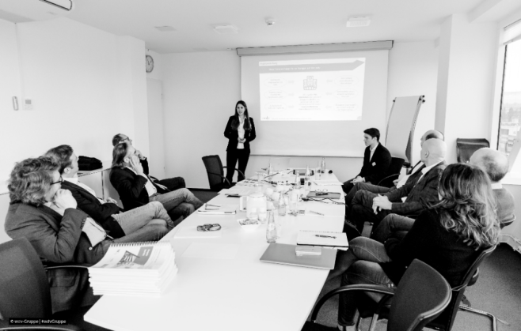




















Hone your skills by working on real-world business projects!
E&I students have successfully completed 850+ diverse innovation projects with start-ups and businesses:
Work in small teams (4-6 students)
Apply methods like expert interviews, user surveys, business model canvas, etc.
Get individual support from lecturers and external coaches like strategy consultants or venture capitalists

Slide 15
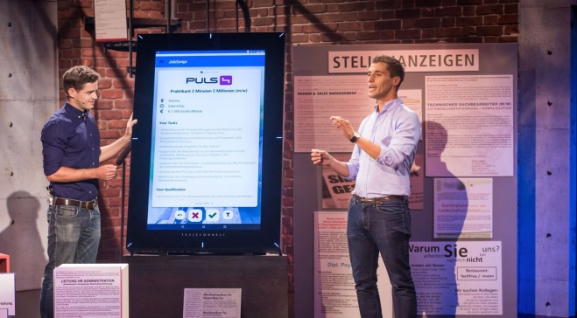













Or try your hand at starting your own business as part of Garage…
E&I students have successfully founded various start-ups during and after the E&I specialization:
Work on your own ideas in diverse teams (WU, TU, BOKU)
Validate your business model and learn how to pitch in front of investors
Get unique insights from successful founders and experienced market experts

Slide 16

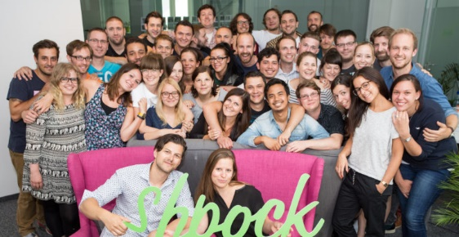
…and follow into the footsteps of successful founders & E&I alumnae
  Cornelia Daniel, founder of Dachgold Katharina Klausberger, founder of shpock https://www.tausendundeindach.at/ https://www.shpock.com
Notes:
Female entrepreneurship could be verbally addressed here, if wanted

Slide 17







A “typical” E&I project course
Internal kick-off
Project work
Desk research and/or data collection
Application of specific methods to discover appropriate solutions
Development of recommendations
Final presentation
March 2024
April 2024
May 2024
June 2024
Project partner meeting
Coachings
Mid-term presentation
E&I Touchdown
Get to know
Coordination
Discussion
Presentation workshop
Interview techniques

Slide 18
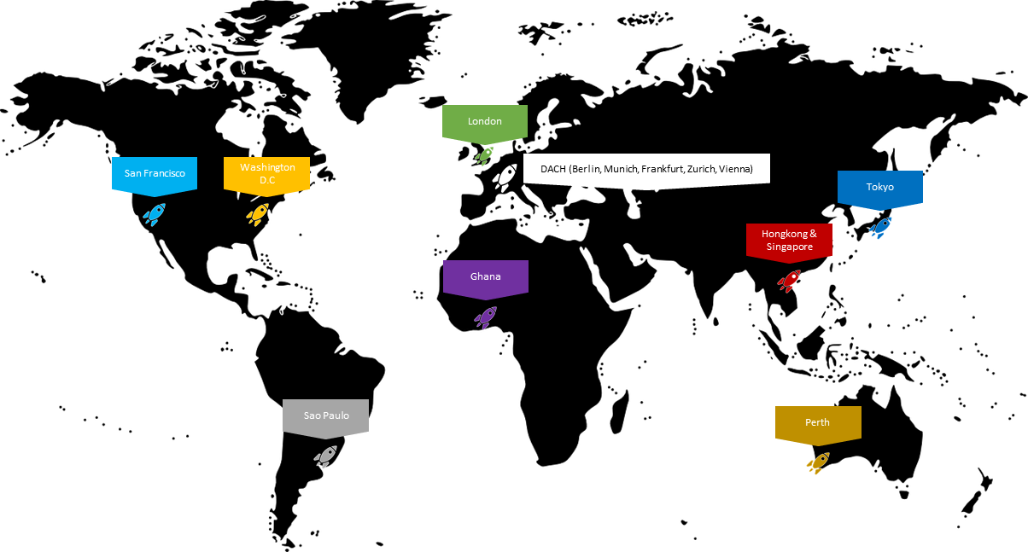
We go the extra mile for our students
Global E&I Alumni Network: Strong, diverse, entrepreneurial network of 3,000+ E&I alumni (BSc, MSc, MBA, PhD)
E&I Hubs: Informal Alumni meetups around the world (mostly in cities with a strong start-up scene/ecosystem)
Various on-site events in Vienna:
E&I Stammtisch@Alumni corporates/start-ups; Aperitivo (WU Ball); professional skills workshops; meet & mingles
Job billboard (Linkedin group)
For more information or contact details of our E&I HUB managers contact benjamin.monsorno@wu.ac.at

Slide 19

For challenging yourself, you will be rewarded with diverse career perspectives
Innovation management
Management consulting
Strategic consulting
Product management
Marketing
Starting your own
venture
Start-up scene
Venture capital
and investment
And all other jobs where an entrepreneurial mindset and strong innovation capabilities matter!

Slide 20

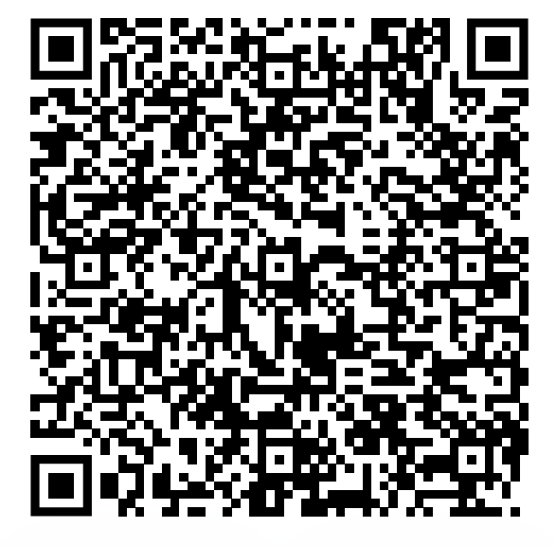
Don’t take our word for it, stop by and experience E&I
… at the
E&I Touchdown
22/01/2024, 6:00 PM
WU Vienna, LC
Festsaal 1
E&I students pitch their innovative solutions to a jury of experts and a broad audience, competing for the Best-Pitch Award.
For more information, please check our social media channels or our website.

Slide 21










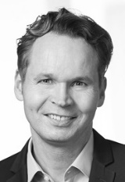




And meet our faculty
Institute for Entrepreneurship and Innovation Chair
E&I Team
Institute for Strategy, Technology and Organization Chair
IfSTO Team

Slide 22






Or speak to our E&I Ambassadors
https://www.wu.ac.at/en/entrep/lehre/bachelor-program-sbwl/ei-ambassadors/
Notes:
The E&I Ambassadors are current and former students of the SBWL and can give you first-​hand insights into our specialization based on their personal experience.

Slide 23
Application process overview
60 students will be admitted in the summer term 2024
Criteria:
  WU student ranking:
  If you are within the top 5% of your cohort, you will be accepted automatically.
    Please make sure that all required grades are listed in time in the ranking you submit to us!
    Please visit www.wu.ac.at/entrep/apply for more information!
  Exceptional E&I skills & CV:
  At least 20 students are accepted ONLY based on their skills
Same application process for all WU study programs!

Slide 24
Application process dates
www.wu.ac.at/entrep/apply
→ Registration via LPIS and online application form is mandatory for all entry modes!
Important dates:
  Feb 01, 2024: Application form online
  Feb 01, 2024: Application period and registration via LPIS starts
  Feb 04, 2024: Final application deadline
  Feb 07, 2024: Notifications about acceptance
  Mar 03, 2024: Welcome @ E&I

Slide 25


Keep in mind, E&I means diversity
Diverse teams are more creative, identify better opportunities, and complement each other regarding skills and competences
This is why we particularly encourage “unusual suspects” to apply for E&I!

Slide 26





For more information get in touch
www.wu.ac.at/entrep
www.wu.ac.at/ifsto
E&I @wu.entrepreneurship.innovation
wuentrepreneurship
Institute for Entrepreneurship & Innovation, WU Vienna

Slide 27

^^
Thank you for your attention!
We look forward to seeing you soon - latest at the next E&I Touchdown!

